Slide 1
Chapter 4 Introduction to Cascading Style Sheets (CSS): Part 1

Slide 2
HTML Styles
<font size=“14px”>
My First Header
</font>
<font size=“12px” color=“red” face=“Verdana”>
My information 1 goes here.
</font>
<font size=“14px”>
My Second Header
</font>
<font size=“12px” color=“red” face=“Verdana”>
Different information goes here.
</font>

Slide 3
Why CSS
Separate Content from Styles

Slide 4
Why CSS?.
Separate Content from styles
Content
Form or Style
<p class=“header”>My First Header</p>
<p class=“info”>My Information 1 goes here</p>
<p class=“header”>My Second Header</p>
<p class=“info”>Different Information goes here</p>
(Specific markup properties like Class will be discussed later).
.header { font-size:14px;}
.info { font-family: verdana;
font-color: blue;
font-size: 12px; }

Slide 5
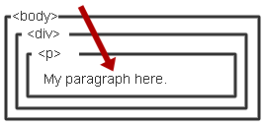
What is CSS?
Cascading Style Sheet
Stylesheet Language
Standards-based set of properties and attributes to define styles
To describe the presentation a document written in a ‘markup language’ like HTML or XML
Markup encoding: <p>My paragraph here.</p>
Defines the style of how things in <p> tags appear.
Font, color, size, margins, etc.
Cascading
Rules to determine how to apply markup that contains other markup

Slide 6
4.1 CSS Validator
CSS validator
jigsaw.w3.org/css-validator/
This tool can help you make sure that your code is correct and will work on CSS3-compliant browsers.

Slide 7
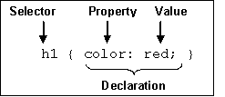
CSS Syntax
Elements to a CSS Statement
Selector
What HTML sections does it affect?
Property
What attribute of that HTML section will be affected?
Value
What change will be made to that attribute?

Slide 8
Levels of Styles
There are three levels of style sheets
Inline - specified for a specific occurrence of a tag and apply only to that tag
This is fine-grain style, which defeats the purpose of style sheets - uniform style
External style sheets - can be applied to any number of documents
<p style=“font-color:red;font-size:10px;”>Content</p>
<link rel="stylesheet" type="text/css" href=“mystylesheet.css" />

Slide 9
Levels of Styles
3. Document-level style sheets - apply to the whole document in which they appear
<head>
<style>
p { background-color: Red;
font-family: serif;
font-color: White; }
</style>
</head>

Slide 10
4.2 Inline Styles
Inline style
declare an individual element’s format using the HTML5 attribute style.
Eg
< p style= “font-siz:20”>
The text to be formatted?
</p>
Each CSS property is followed by a colon and the value of the attribute
Multiple property declarations are separated by a semicolon

Slide 11
4.2 Inline Styles
Style sheet appears as the value of the style attribute
General form:
style = "property_1: value_1;
property_2: value_2;
…
property_n: value_n"

Slide 12
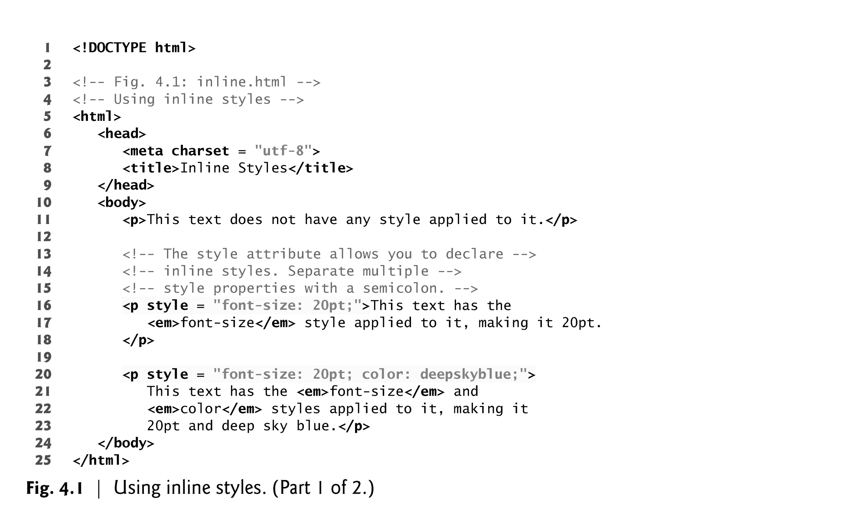
Figure 4.1 applies inline styles to p elements to alter their font size and color.

Slide 13
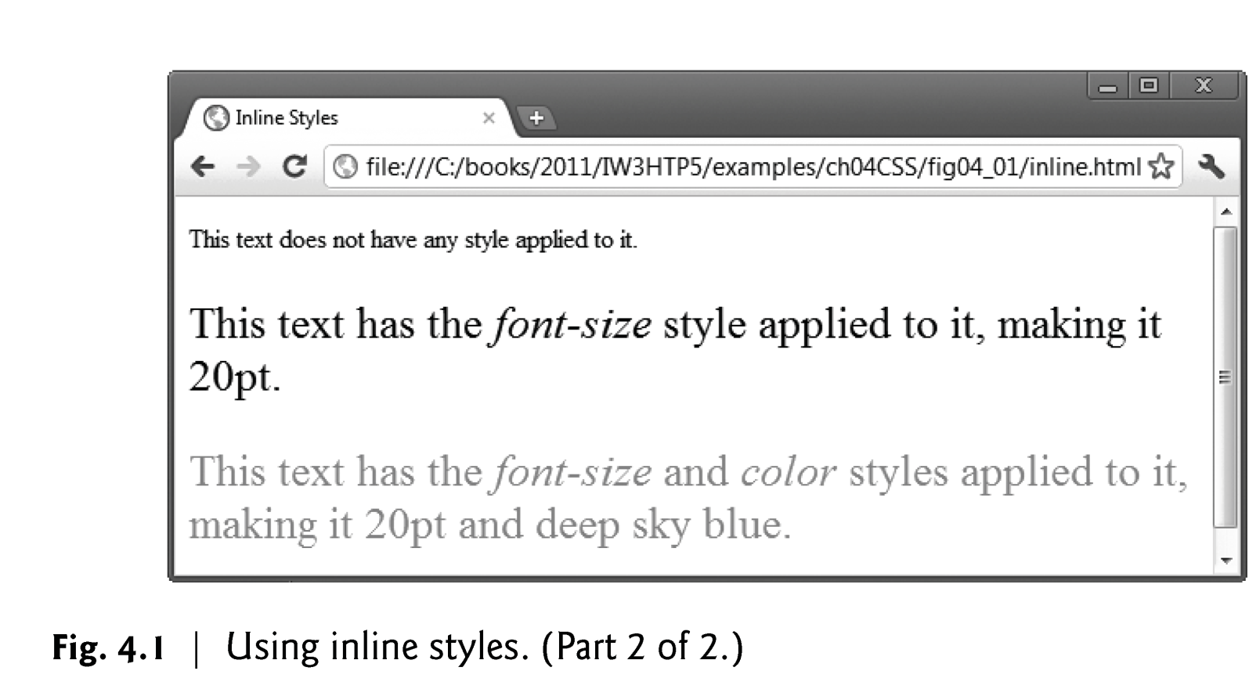

Slide 14
4.3 Embedded Style Sheets
A second technique for using style sheets is embedded style sheets, which enable you to embed a CSS3 document in the document’s head section.
Style sheet appears as a list of rules that are the content of a <style> tag
The <style> tag must include the type attribute, set to "text/css"

Slide 15
4.3 Embedded Style Sheets
General form:
<style type = "text/css">
rule list
</style>
Form of the rules:
selector {list of property/values}
Each property/value pair has the form:
"property_1: value_1; property_2:value_2;
Comments in the rule list must have a different form - use C comments (/*…*/)

Slide 16
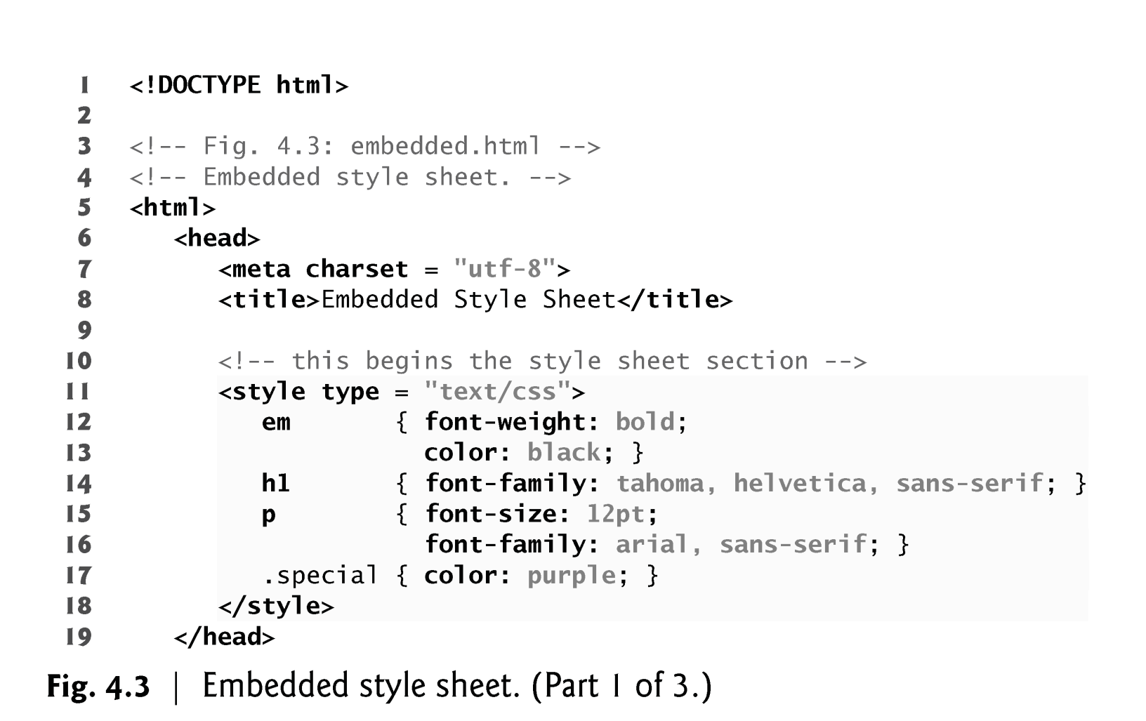
Example

Slide 17
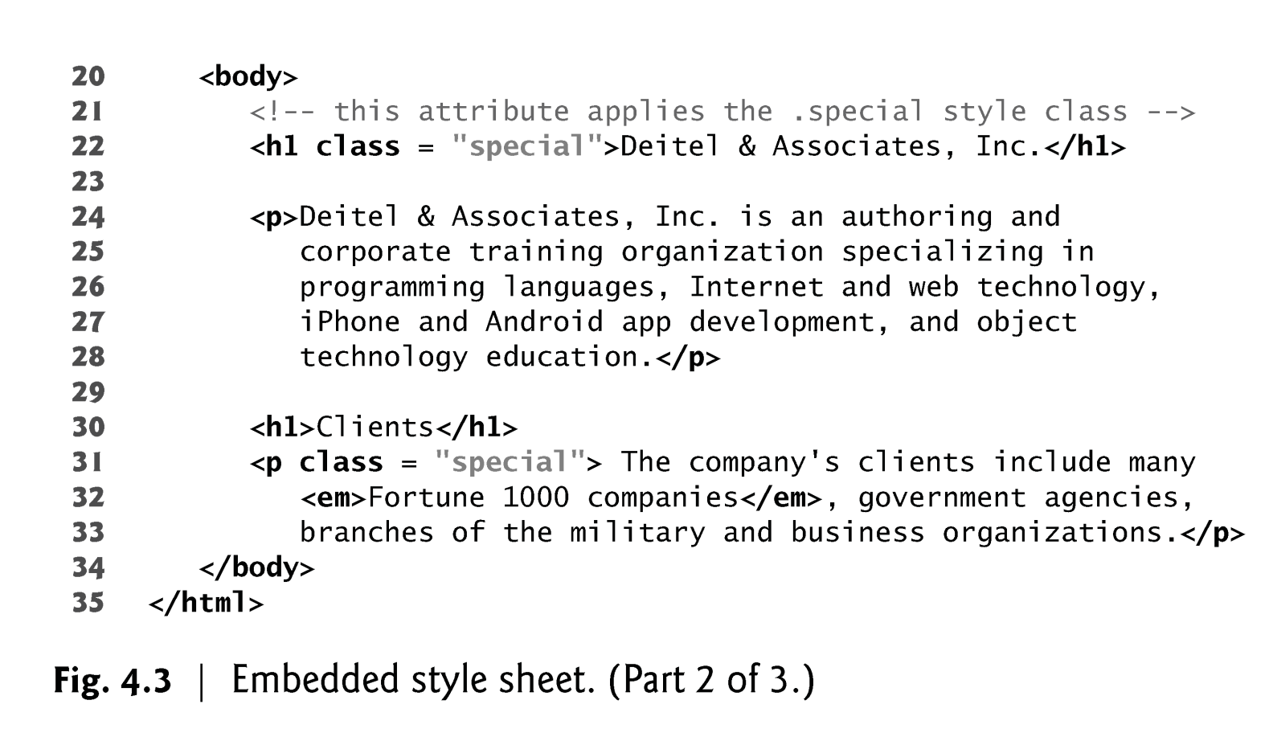
Notes:
MIME (Multi-Purpose Internet Mail Extensions) is an extension of the original Internet e-mail protocol that lets people use the protocol to exchange different kinds of data files on the Internet: audio, video, images, application programs, and other kinds, as well as the ASCII text handled in the original protocol, the Simple Mail Transfer Protocol(SMTP).

Slide 18
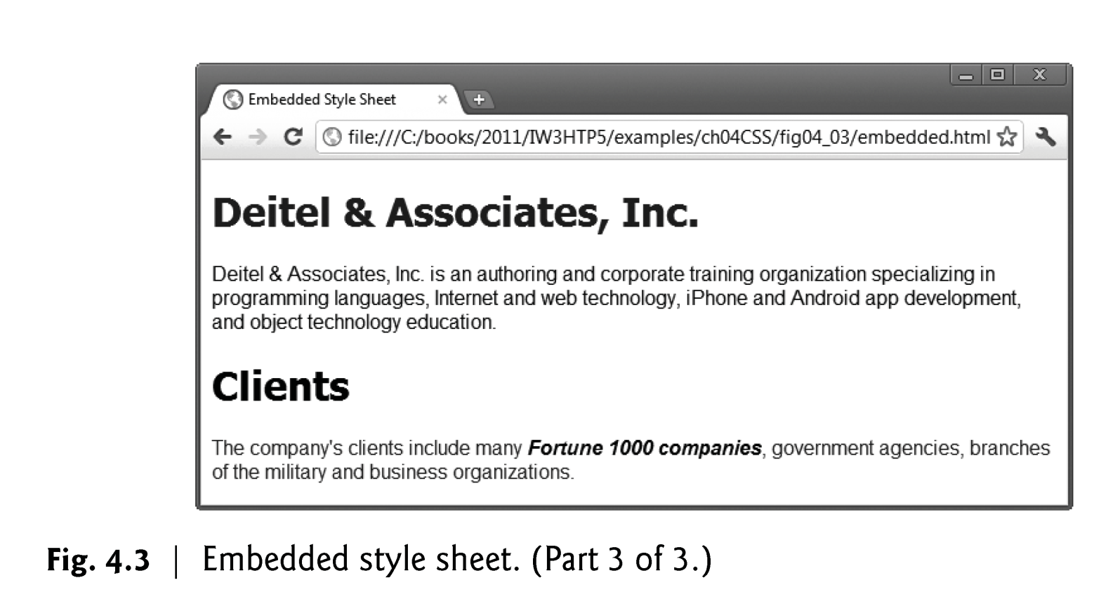

Slide 19
4.3 Embedded Style Sheets (cont.)
The <style> Element
style element type attribute specifies the MIME type (the specific encoding format) of the style sheet.
Style sheets use text/css.
Each rule body in a style sheet is enclosed in curly braces ({ and }).
CSS selector to specify the elements that will be styled according to a rule.
An em element indicates that its contents should be emphasized.
em {font-weight:bolder ; color: #006600}
Notes:
MIME (Multi-Purpose Internet Mail Extensions) is an extension of the original Internet e-mail protocol that lets people use the protocol to exchange different kinds of data files on the Internet: audio, video, images, application programs, and other kinds, as well as the ASCII text handled in the original protocol, the Simple Mail Transfer Protocol(SMTP).

Slide 20
3.4 Selector Forms
1. Simple Selector Forms
The selector is a tag name or a list of tag names, separated by commas
Examples:
h1, h3
p
2. Class Selectors (style classes)
Used to allow different occurrences of the same tag to use different style specifications
A style class has a name, which is attached to a tag name
For example,
p.narrow {property/value list}
p.wide {property/value list}

Slide 21
2. Class Selectors (continued)
The class you want on a particular occurrence of a tag is specified with the class attribute of the tag
For example,
<p class = "narrow">
...
</p>
...
<p class = "wide">
...
</p>

Slide 22
2. Class Selectors (continued)
3. Generic Selectors
A generic class can be defined if you want a style to apply to more than one kind of tag
A generic class must be named, and the name must begin with a period
Example,
.special {color: purple}
Use it as if it were a normal style class
<h1 class = "special "> Weekend Sale </h1>
...
<p class = "special "> … </p>
class special sets color to purple

Slide 23
2. Class Selectors (continued)
id Selectors
An id selector allows the application of a style to one specific element
General form:
#specific-id {property-value list}
Example:
<HEAD>
<style>
#z98y { letter-spacing: 0.3em }
</style>
</HEAD>
<body>
<p id=z98y> This in internet Programming</p>
</body>

Slide 24
2. Class Selectors (continued)
<HEAD>
<STYLE>
h1#z98y { letter-spacing: 0.5em }
</STYLE>
</HEAD>
<BODY>
<p id=z98y>Wide text</p>
</BODY>
In this example, however, the style rule will only match an H1 element that has id="z98y". The rule will not match the P element in this example:

Slide 25
2. Class Selectors (continued)
5. Contextual Selectors
Match elements that appear in a certain context, such as "only those <em> elements that are contained by an <h1> element"
Descendant Selector
h1 em
– applies to em when it is in a h1 element
Example
h1 em { color: blue }
<h1>This headline is <em>very</em> big</h1>

Slide 26
2. Class Selectors (continued)
Parent -Child Selectors
Matches when an element is the direct descendent of some parent element
body ~ p
– applies to p when it is a child of a body element
Example
The following rule sets the style of P elements that are children of BODY:
body ~ p { line-height: 1.3 }

Slide 27
2. Class Selectors (continued)
6. Universal Selectors
* {color: red;}
- Applies to all elements in the document
7. Attribute selectors
Applies to an element that has defined an Attribute
For example, the following rule matches all H1 elements that specify the "href" attribute, whatever its value:
h1[href] { color: blue; }

Slide 28
Class Selectors (continued)
7. Pseudo Classes
Pseudo classes are styles that apply when something happens, rather than because the target element simply exists
Names begin with colons
hover classes apply when the mouse cursor is over the element
focus classes apply when an element has focus
link classes apply when a link has not been selected
visited classes apply when a link previously has been selected

Slide 29
4.5 External Style Sheets
External style sheets are separate documents that contain only CSS rules.
Help create a uniform look for a website
Separate pages can all use the same styles.
Modifying a single style-sheet file makes changes to styles across an entire website (or to a portion of one).
When changes to the styles are required, you need to modify only a single CSS file to make style changes across all the pages that use those styles.
This concept is sometimes known as skinning.

Slide 30
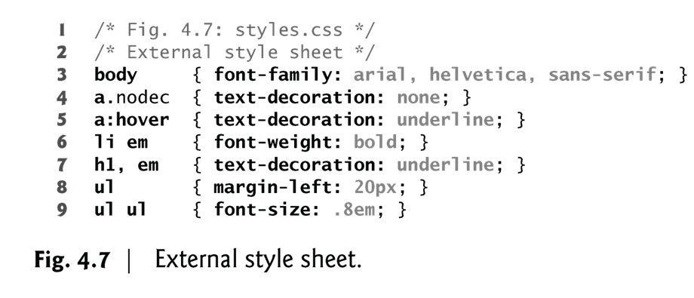
4.5 Linking External Style Sheets (Cont.)
Figure 4.7 presents an external style sheet.
CSS comments may be placed in any type of CSS code (i.e., inline styles, embedded style sheets and external style sheets) and always start with /* and end with */.

Slide 31
4.5 Linking External Style Sheets (Cont.)
A <link> tag is used to specify that the browser is to fetch and use an external style sheet file
<link rel = "stylesheet" type = "text/css"
ref="termpaper.css">
</link>
External style sheets can be validated
http://jigsaw.w3.org/css-validator/

Slide 32
4.5 Linking External Style Sheets (Cont.)
link element
rel attribute declares the linked document to be a stylesheet for the document
type attribute specifies the MIME type of the related document
href attribute provides the URL for the document containing the style sheet

Slide 33
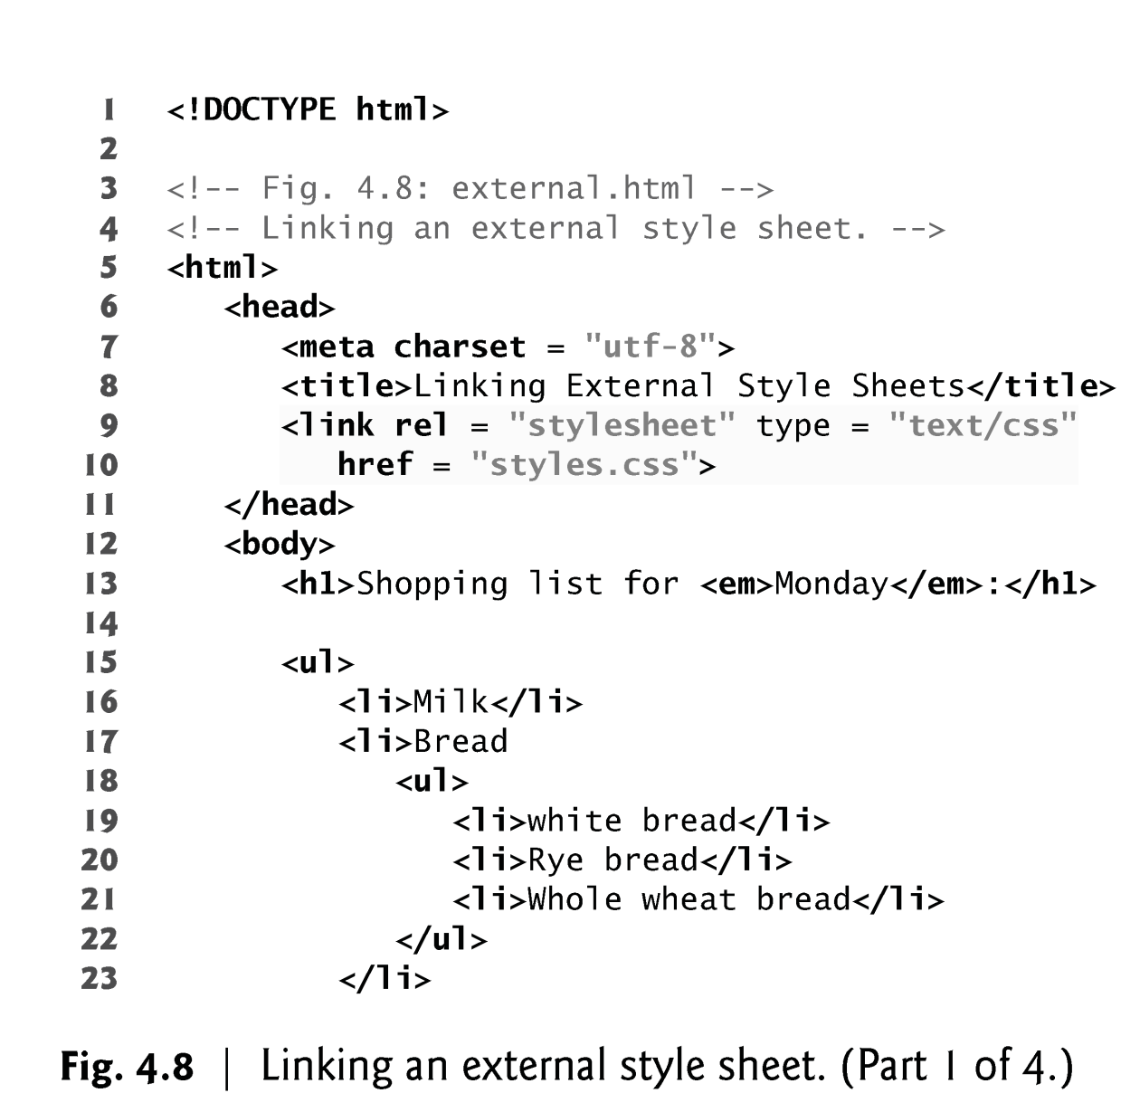

Slide 34
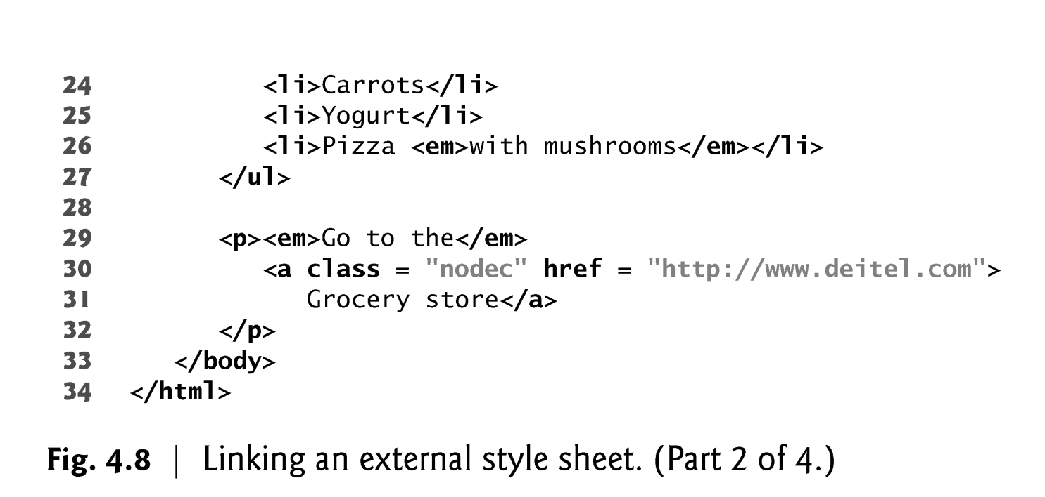

Slide 35
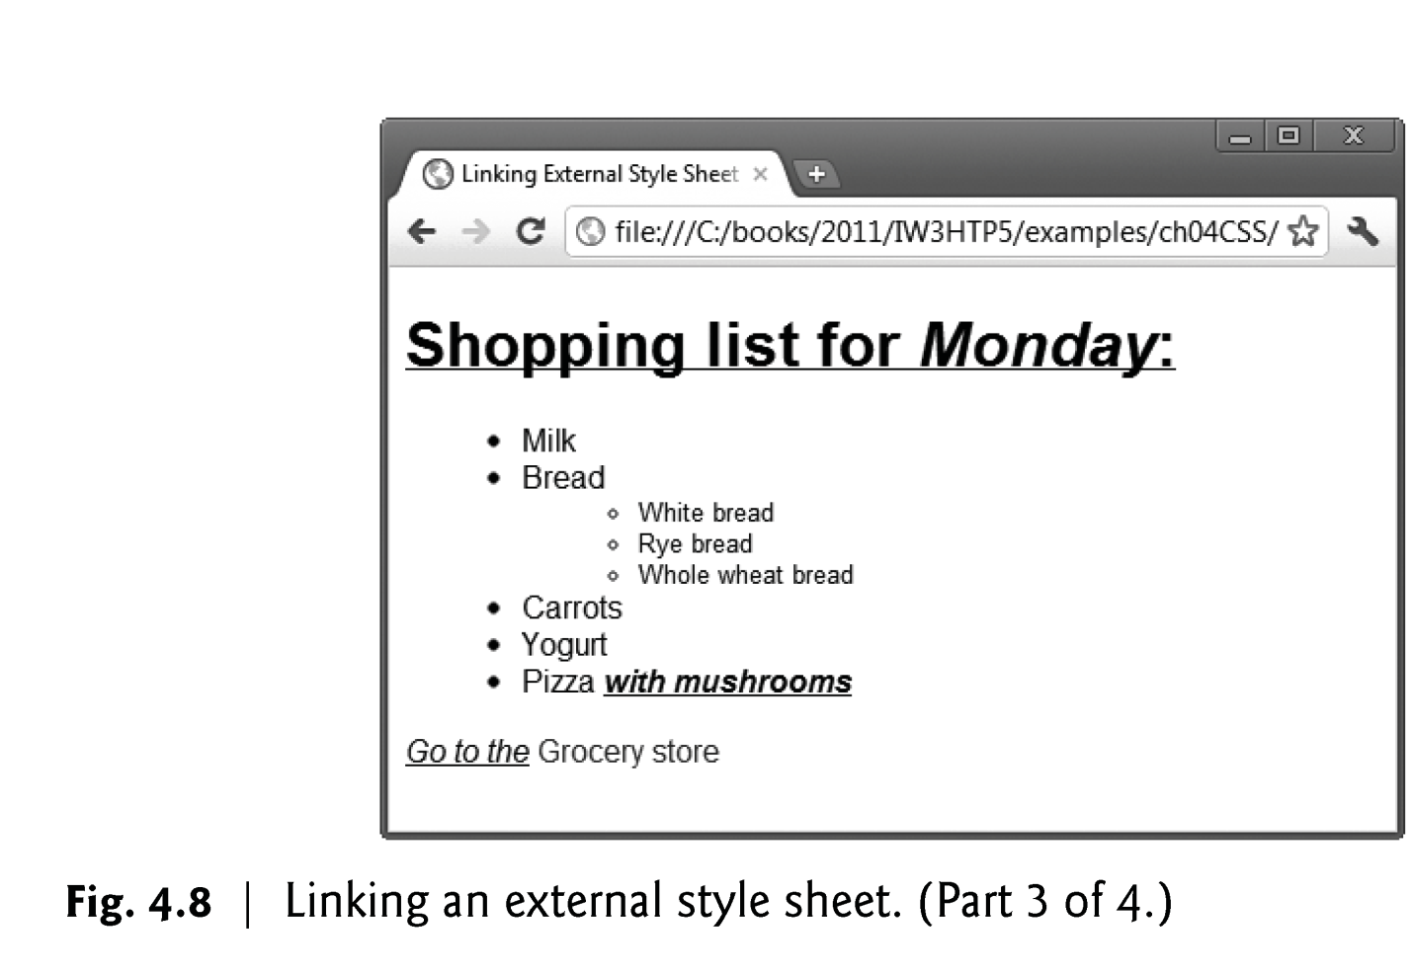

Slide 36
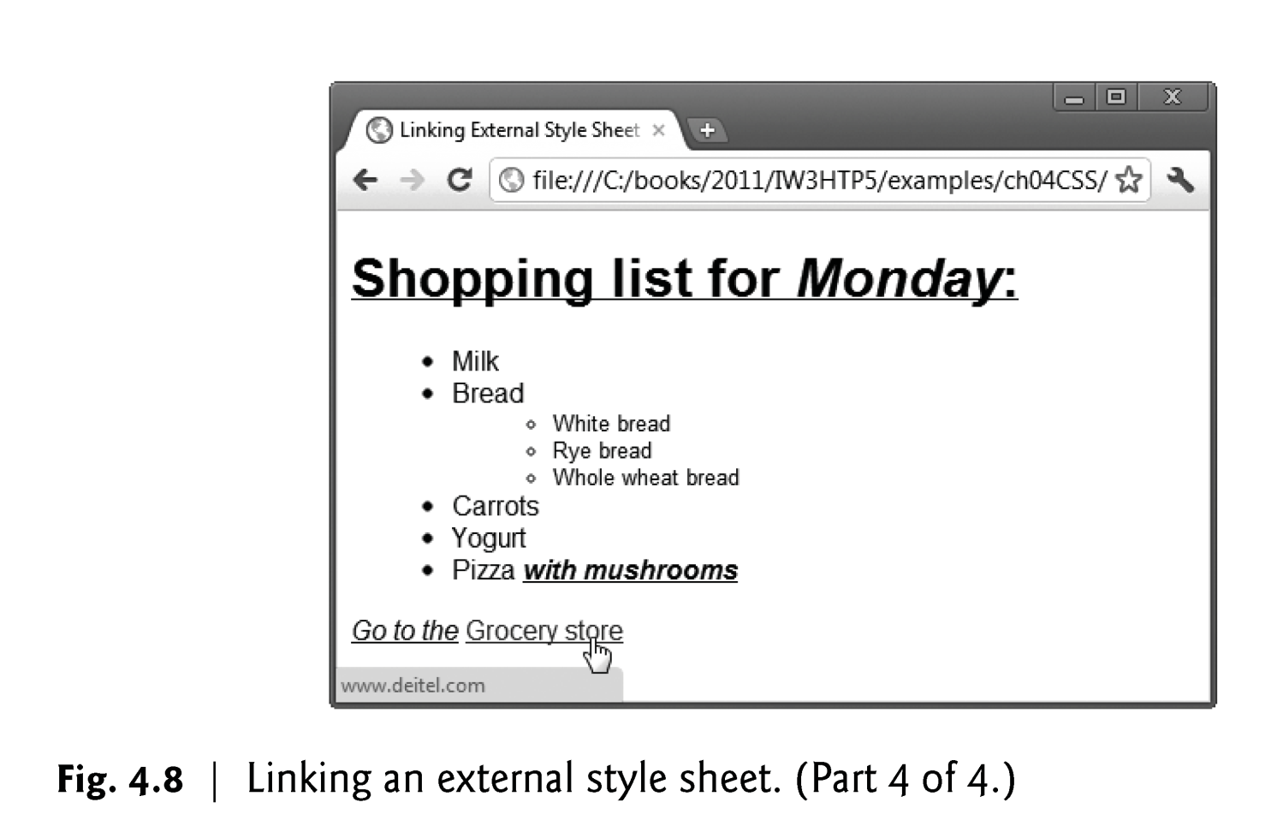

Slide 37
The <span> and <div> tags
One problem with the font properties is that they apply to whole elements
Solution: a new tag to define an element in the content of a larger element - <span>
The default meaning of <span> is to leave the content as it is
<p>
Now is the <span> best time </span> ever!
</p>

Slide 38
The <span> and <div> tags
Use <span> to apply a document style sheet to its content
<style type = "text/css">
.bigred {font-size: 24pt;
font-family: Ariel; color: red}
</style>
...
<p>
Now is the
<span class = "bigred">
best time </span> ever!
</p>

Slide 39
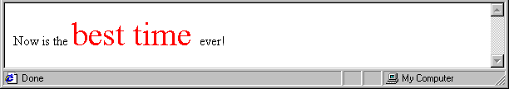
The <span> and <div> tags
The <span> tag is similar to other HTML tags, they can be nested and they have id and class attributes
Another tag that is useful for style specifications: <div>
Used to create document sections (or divisions) for which style can be specified

Slide 40
5.4 Applying a Style Class
More than one style sheet can simultaneously influence a the presentation of a document and rules from these style sheets may overlap in scope
In many cases, the styles applied to an element (the parent or ancestor element) also apply to the element’s nested elements (child or descendant elements).
Multiple values of one property can be set or inherited on the same element, so the browser must reduce them to one value for that property per element before they’re rendered.

Slide 41
5.4 Conflicting Styles
Styles may be defined by a user, an author or a user agent (browser).
Styles cascade (and hence the term “Cascading Style Sheets”), or flow together, such that the ultimate appearance of elements on a page results from combining styles defined in several ways.
Styles defined by the user take precedence over styles defined by the user agent.
Styles defined by authors take precedence over styles defined by the user.
Most styles defined for parent elements are also inherited by child (nested) elements.
Notes:
Your user agent is your browser, different browsers set different default CSS rules

Slide 42
Conflict Resolution
A conflict occurs when there are two or more values for the same property on the same element
Sources of conflict:
Conflicting values between levels of style sheets
Within one style sheet
Inheritance can cause conflicts Property values can come from style sheets written by the document author, the browser user, and the browser defaults

Slide 43
Cascading order
Sort the declarations by explicit weight: declarations marked '!important' carry more weight than unmarked (normal) declarations.
Sort by origin: the author's style sheets override the reader's style sheet which override the UA's default values.
Sort by specificity of selector: more specific selectors will override more general ones..
Sort by order specified: if two rules have the same weight, the latter specified wins.

Slide 44
Cascading order
Inheritance
properties are passed from parent to child
For example, body {font-family: Georgia;}inherited by all child elements of the body and make every font on the page display as Georgia.
Specificity
p {font-family: Georgia;} p.feature {font-family: Arial;}
selector p.feature is more specific than the selector p
selecting a paragraph that belongs to a particular class is a more specific choice than selecting all paragraphs

Slide 45
Cascading order
!important
rules that are declared !important.
!important rules always overrule other rules, no matter what inheritance, source order or specificity might otherwise do
*{font-family: Arial !important;} would mean that everything would be Arial no matter what other rules were used in the CSS.
The Cascade
Source order means the order in which rules appear in the style sheet
body {font-family: Georgia;} h1, h2, h3 {font-family: Arial;}
headings would display in Arial, not in Georgia

Slide 46
Conflict Resolution
All available specs, from all sources, are sorted by origin and weight, using the following rules, which are given in precedence order:
a. Important declarations with user origin
b. Important declarations with author origin
c. Normal declarations with author origin
d. Normal declarations with user origin
e. Any declarations with browser (or other user agent) origin

Slide 47
Conflict Resolution
Example: 'Important' rules
h1 { color: black !important;}
p { font-size: 12pt ! Important; font-variant: italic}
In the example above, the first 2 declarations have increased weight, while the last declaration has normal weight.

Slide 48
Exercise
The browser style sheet may include the following relevant rule:
h2 {font-size:1.5em; margin:3em; color: black}
The users style sheet could include the following relevant rules
h2 { color: brown !important; }
The author style sheet could include the following relevant rules:
h2 {color: green; font-size:1.2em; padding:10px;} h2#main { color: red; } h2.navigation {color: blue;}
What would be the format for h2?
Font-size? Margin? Padding? Color?

Slide 49
Exercise
font-size: 1.2em; /* author wins over browser */
margin: .3em 0; /* specified only by browser */
padding: 10px; ; /* specified only by author */
color: brown; /* user wins due to !important */

Slide 50
Property Value Forms
There are 60 different properties in 7 categories:
- Fonts
- Lists
- Alignment of text
- Margins
- Colors
- Backgrounds
- Borders
Property Value Forms
- Not case sensitive
- Length - numbers, maybe with decimal points
- Units:
px - pixels
in - inches
cm - centimeters
mm - millimeters
pt - points
pc - picas (12 points)
em - height of the letter ‘m’
ex - height of the letter ‘x’

Slide 51
Property Value Forms (continued)
Percentage - just a number followed immediately by a percent sign
URL values
- url(protocol://server/pathname)
Colors
- Color name
- rgb(n1, n2, n3)
- Numbers can be decimal or percentages
- Hex form: #XXXXXX

Slide 52
Font Properties
font-family
Value is a list of font names - browser uses the first in the list it has
font-family: Arial, Helvetica, Futura
Generic fonts: serif, sans-serif, cursive, fantasy, and monospace

Slide 53
Font Properties (continued)
font-size
Possible values: a length number or a name, such as smaller, xx-large, etc. Percentages and em are the best
Font variants
Default is normal, but can be set to small-caps
font-style
italic, oblique (useless), normal
font-weight - degrees of boldness
bolder, lighter, bold, normal
font (shorthand)
For specifying a list of font properties
font: bolder 14pt Arial Helvetica
Order must be: style, weight, size, name(s)

Slide 54
Text Alignment
The text-indent property allows indentation
Takes either a length or a % value
The text-align property has the possible values, left (the default), center, right, or justify
Sometimes we want text to flow around another element - the float property
The float property has the possible values, left, right, and none (the default)

Slide 55
Alignment of Text (continued)
<img src = "c210.jpg" style = "float: right" />
-- Some text with the default alignment - left

Slide 56
Colors
There are three color collections
There is a set of 17 colors that are guaranteed to be displayable by all graphical browsers on all color monitors
There are 147 named colors
There is a much larger set, the Web Palette
216 colors
Use hex color values of 00, 33, 66, 99, CC, and FF

Slide 57
Colors
The color property specifies the foreground color of elements
<style type = "text/css" >
th.red {color: red}
th.orange {color: orange}
</style>
…
<table>
<tr>
<th class = "red"> Apple </th>
<th class = "orange"> Orange </th>
<th class = "orange"> Screwdriver </th>
</tr>
</table>
The background-color property specifies the background color of elements

Slide 58
The box model
Borders – every element has a border-style property
Controls whether the element has a border and if so, the style of the border
border-style values: none, dotted, dashed, and double
border-width – thin, medium (default), thick, or a length value in pixels
Border width can be specified for any of the four borders (e.g., border-top-width)
border-color – any color
Border color can be specified for any of the four borders (e.g., border-top-color)

Slide 59
Table Borders
Table borders and table cell borders
To get cell borders:
td, th {border: thin solid black}
To get table borders:
table {border: thin solid black}

Slide 60
The Box Model (continued)
Margin – the space between the border of an element and its neighbor element
The margins around an element can be set with margin-left, etc. - just assign them a length value
<img src = "c210.jpg " style = "float: right; margin-left: 0.35in; margin-bottom: 0.35in" />

Slide 61
The Box Model (continued)
Padding – the distance between the content of an element and its border
Controlled by padding, padding-left, etc.

Slide 62
Background Images
The background-image property
Repetition can be controlled
background-repeat property
Possible values: repeat (default), no-repeat, repeat-x, or repeat-y
background-position property
Possible values: top, center, bottom, left, or right

Slide 63
4.6 Positioning Elements: Absolute Positioning, z-index
CSS position property
Allows absolute positioning, which provides greater control over where on a page elements reside
Normally, elements are positioned on the page in the order in which they appear in the HTML5 document
Specifying an element’s position as absolute removes it from the normal flow of elements on the page and positions it according to distance from the top, left, right or bottom margin of its parent element

Slide 64
4.6 Positioning Elements: Absolute Positioning, z-index (Cont.)
The z-index property allows a developer to layer overlapping elements
Elements that have higher z-index values are displayed in front of elements with lower z-index values

Slide 65
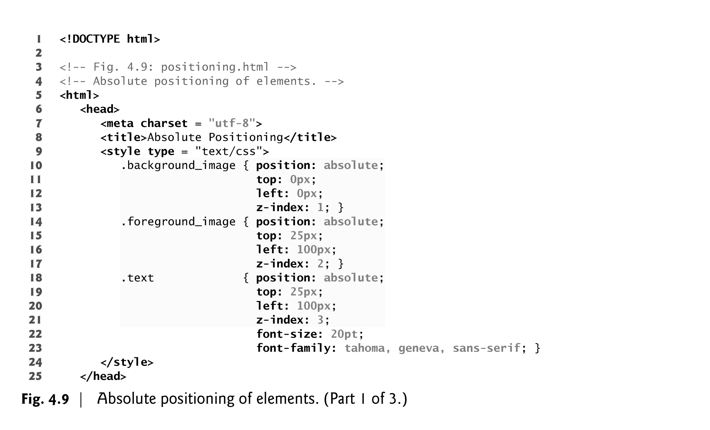

Slide 66
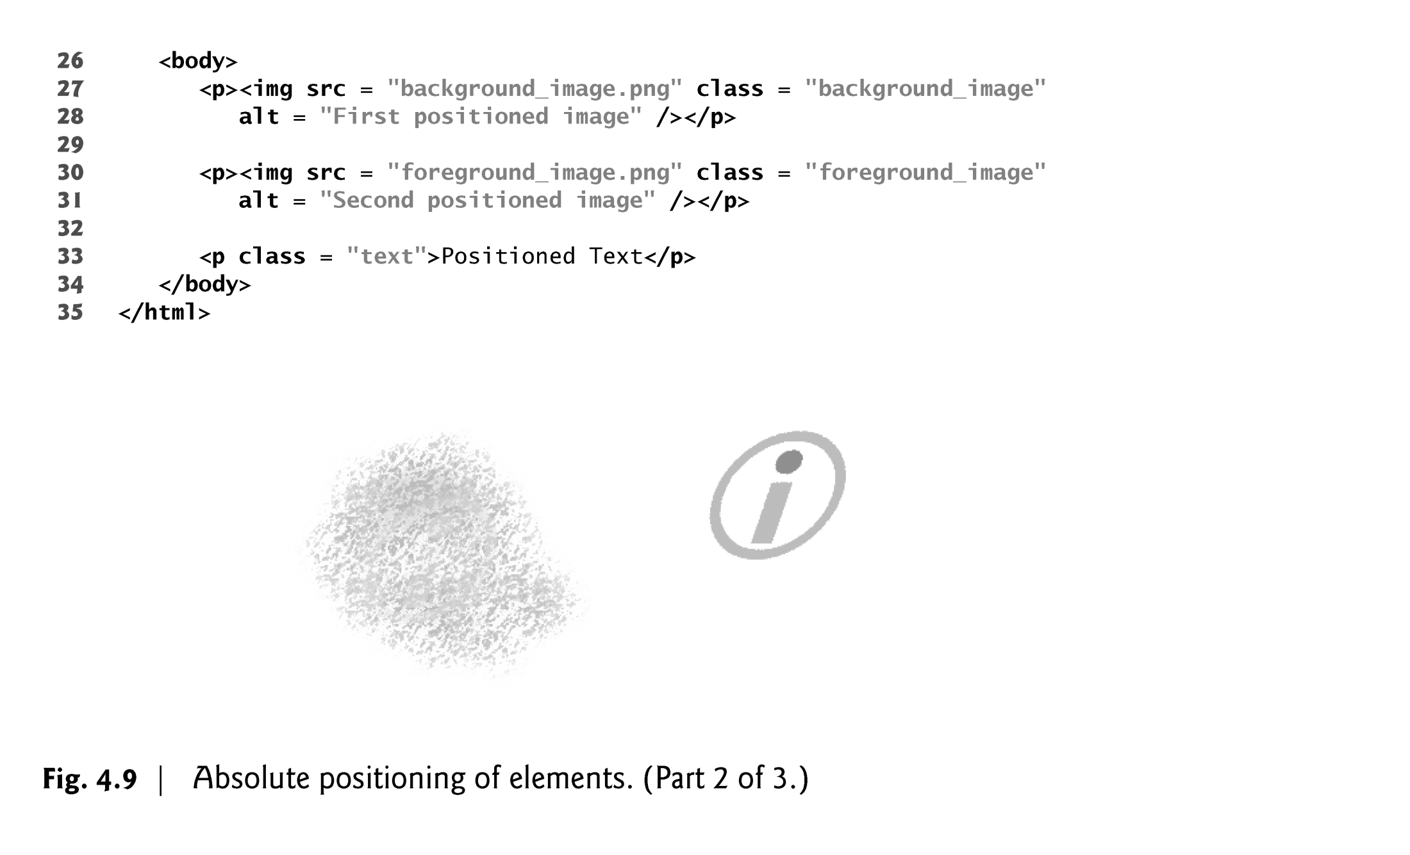

Slide 67
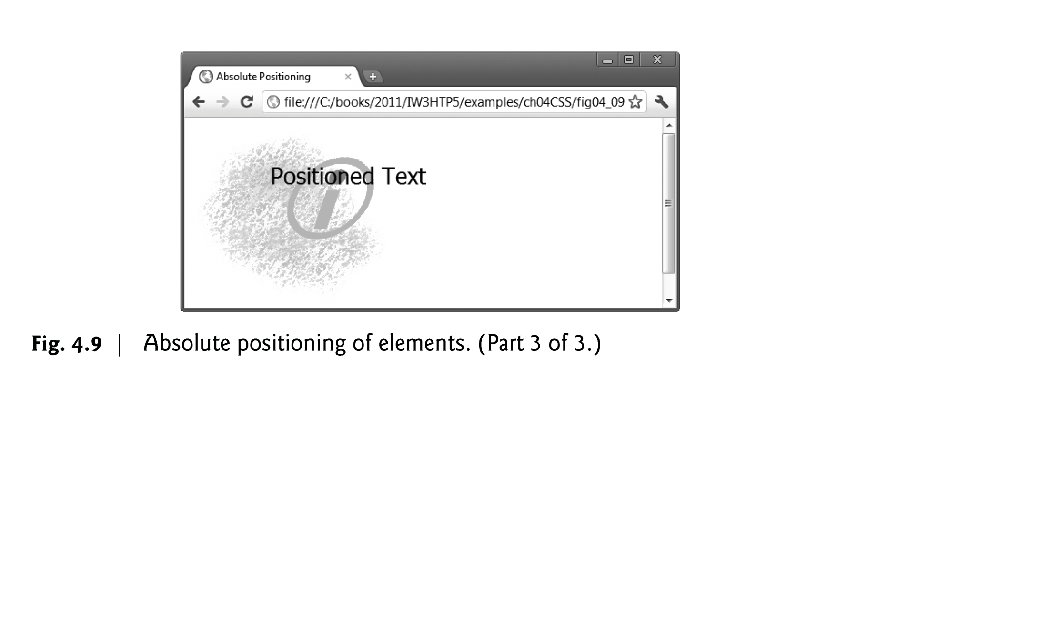

Slide 68
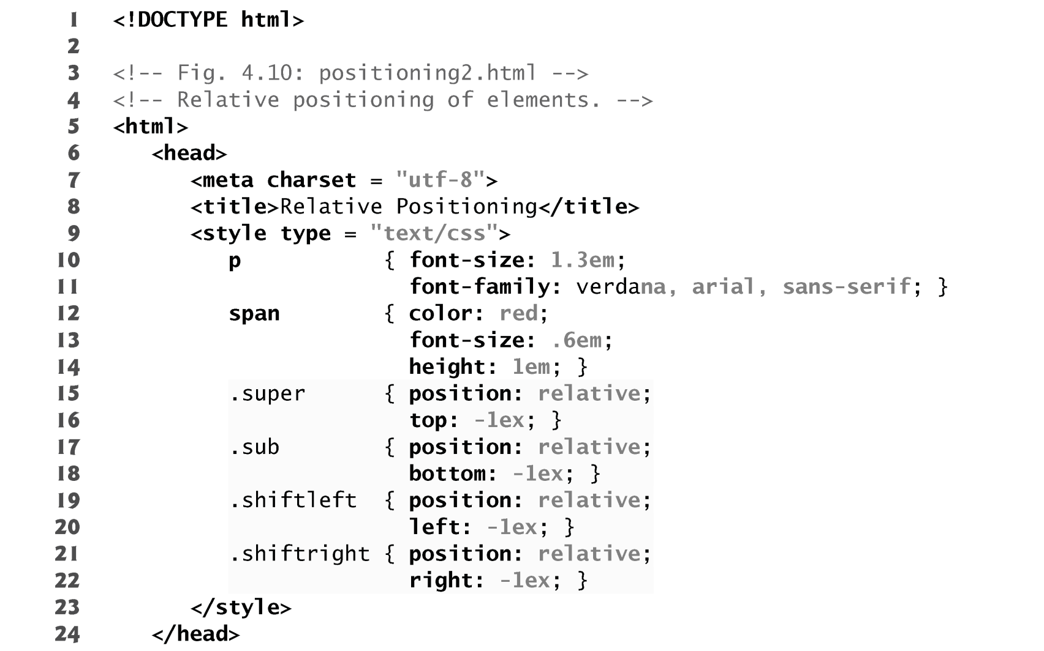
4.7 Positioning Elements: Relative Positioning, span

Slide 69
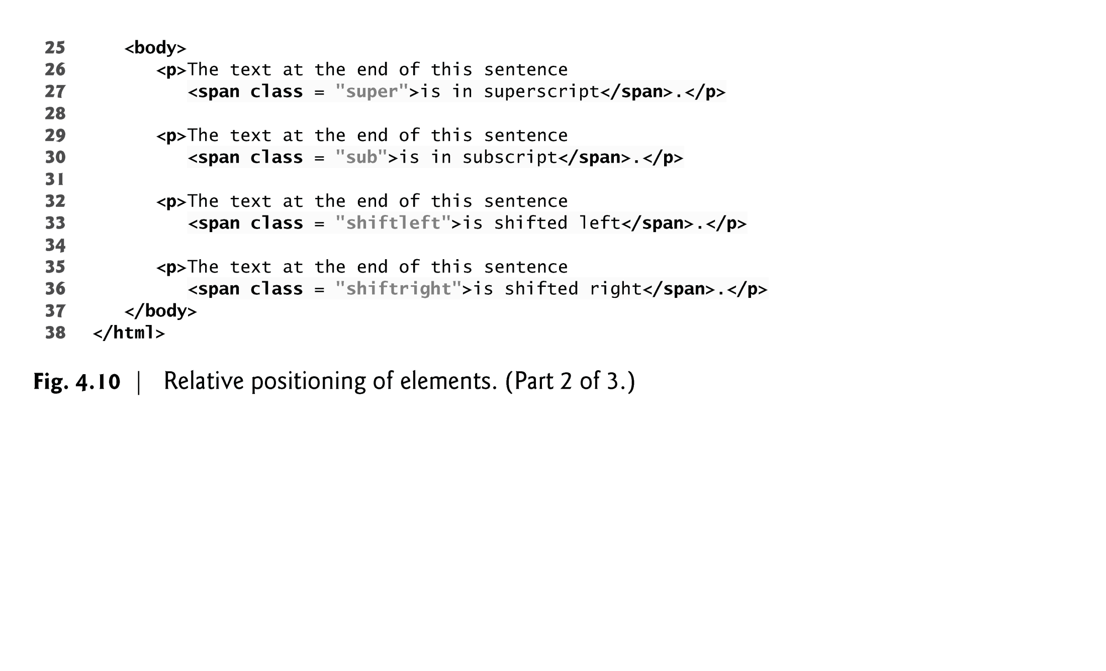

Slide 70
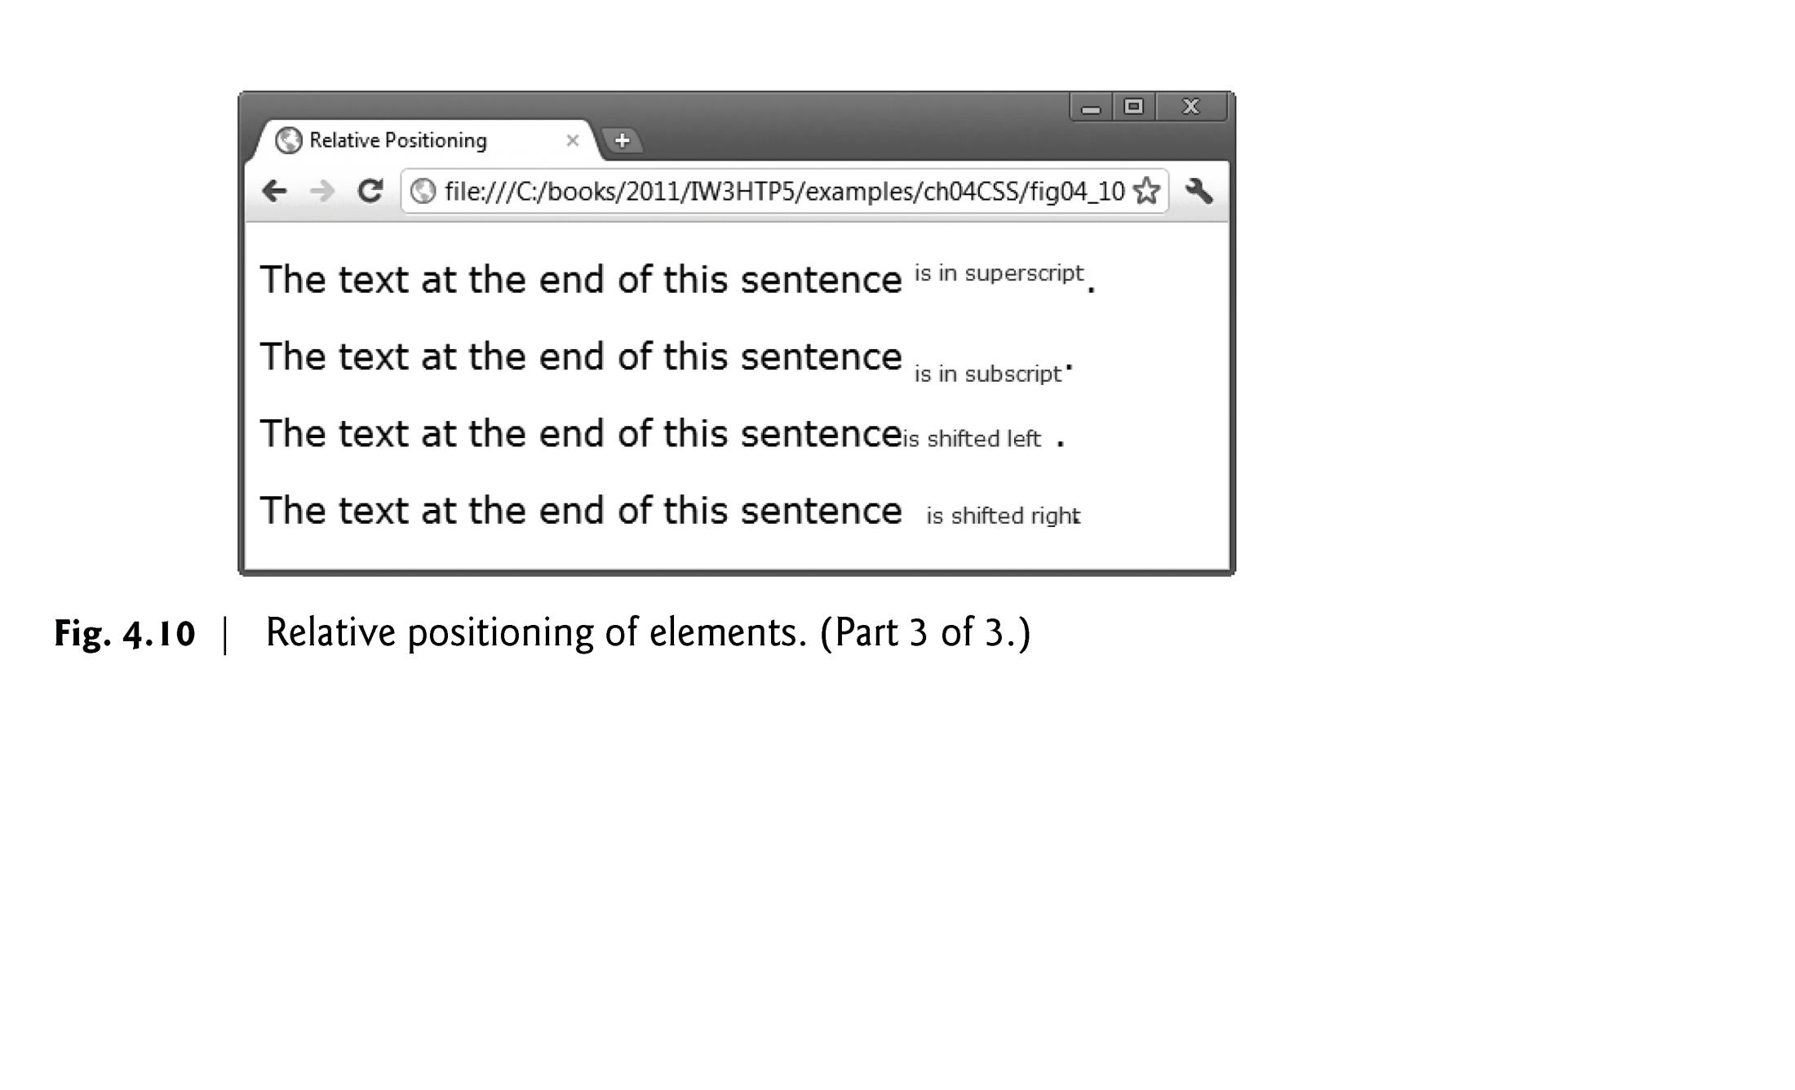

Slide 71
4.7 Positioning Elements: Relative Positioning, span (Cont.)
Inline and Block-Level Elements
Inline-level elements
Do not change the flow of the document
Examples:
img
a
em
strong
span
Grouping element
Does not apply any formatting to its contents
Creates a container for CSS rules or id attributes to be applied to a section

Slide 72
4.7 Positioning Elements: Relative Positioning, span (Cont.)
Block-level elements
Displayed on their own line
Have virtual boxes around them
Examples:
p
all headings (h1 through h6)
div
A grouping element like span

Slide 73
4.8 Backgrounds
CSS can control the backgrounds of block-level elements by adding:
Colors
Images
Figure 4.11 adds a corporate logo to the bottom-right corner of the document. This logo stays fixed in the corner even when the user scrolls up or down the screen.

Slide 74
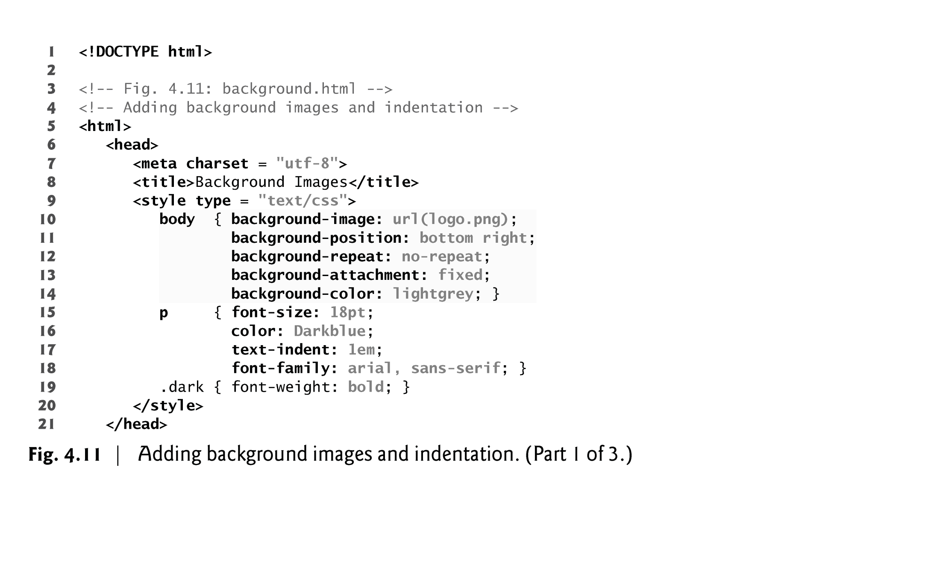

Slide 75
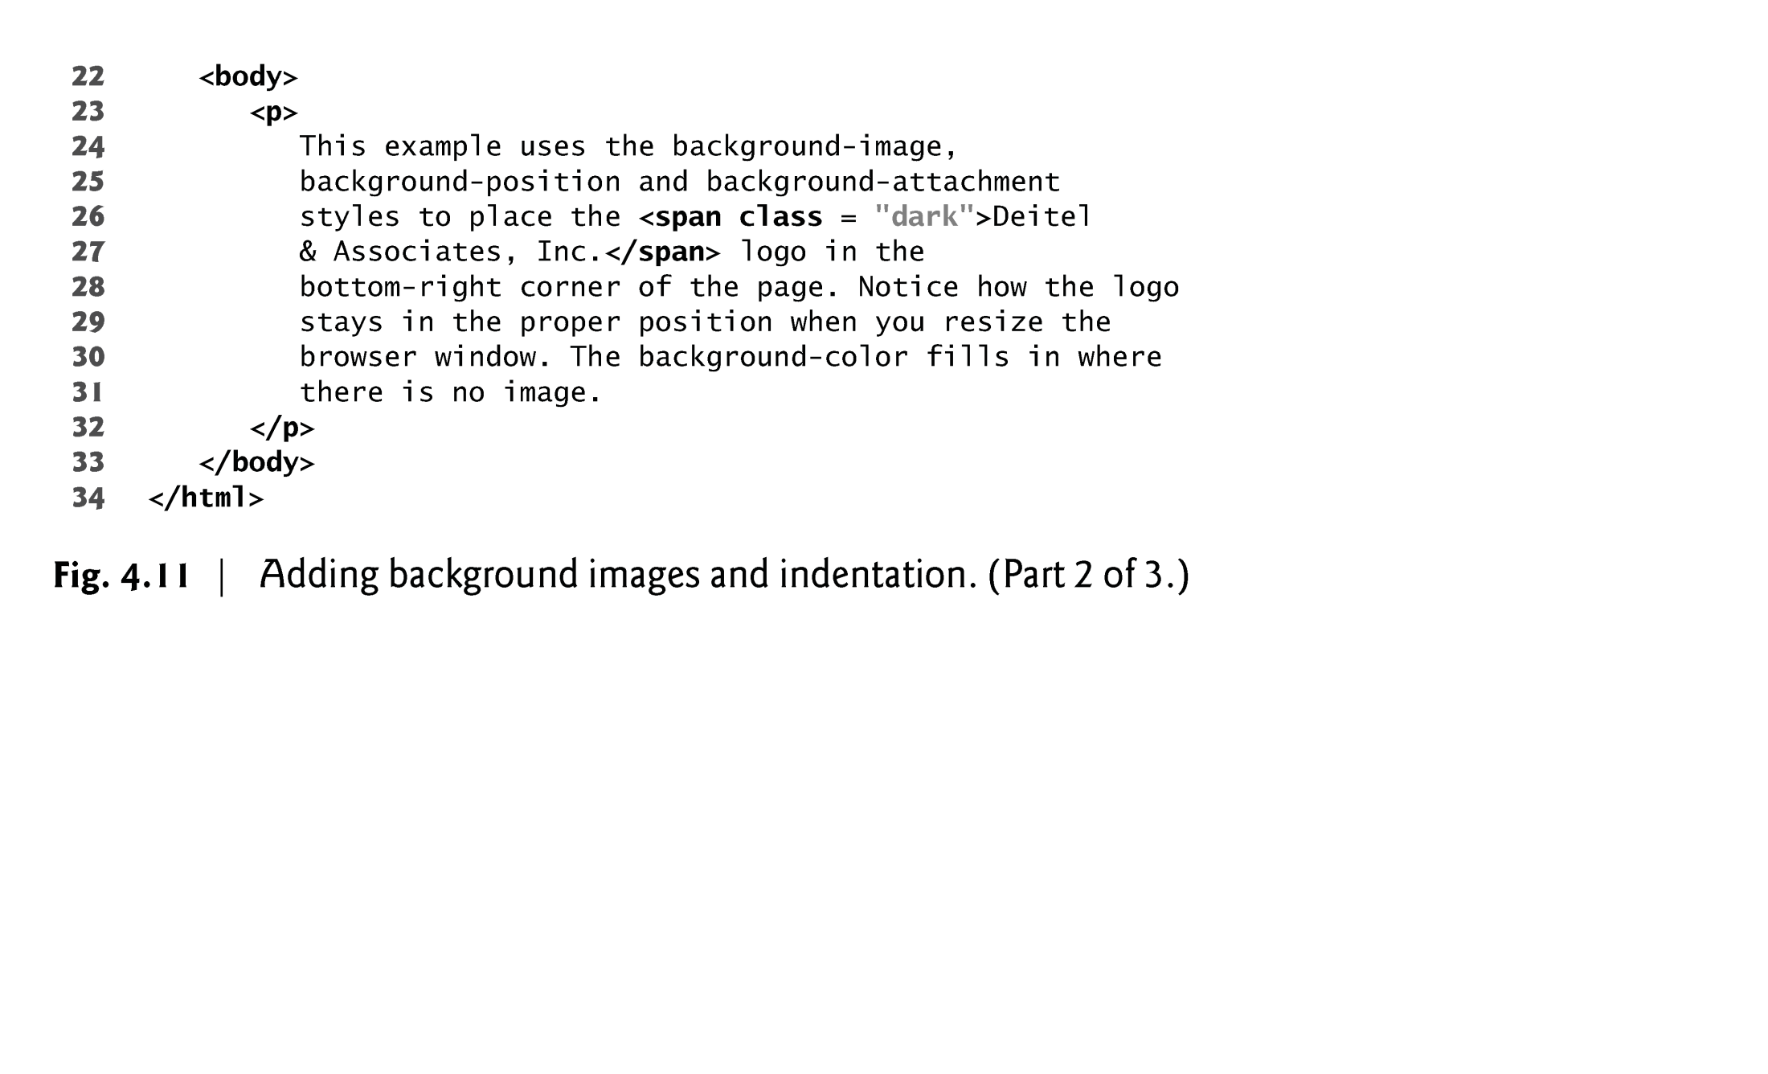

Slide 76
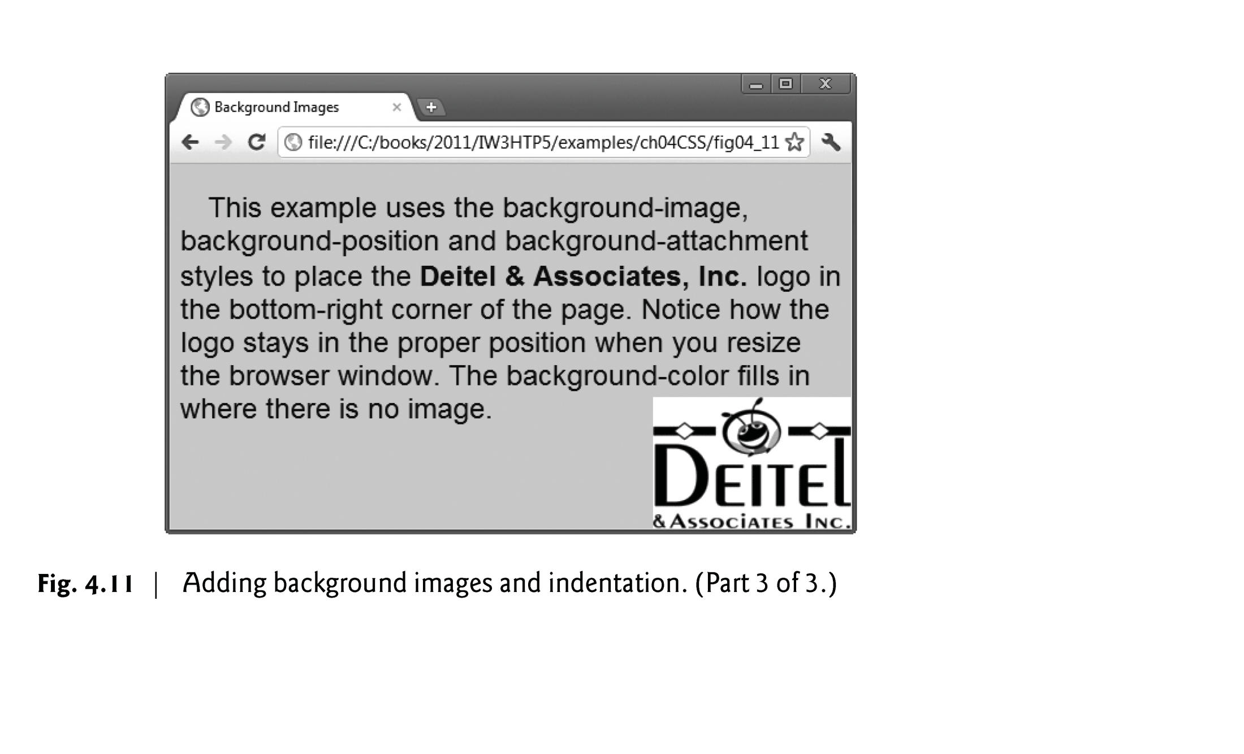

Slide 77
4.8 Backgrounds (Cont.)
background-image Property
Specifies the URL of the image, in the format url(fileLocation)
background-position Property
Places the image on the page using the values top, bottom, center, left and right individually or in combination for vertical and horizontal positioning. You can also position by using lengths

Slide 78
4.8 Backgrounds (Cont.)
background-repeat Property
background-repeat property controls the tiling of the background image
Setting the tiling to no-repeat displays one copy of the background image on screen
Setting to repeat (the default) tiles the image vertically and horizontally
Setting to repeat-x tiles the image only horizontally
Setting to repeat-y tile the image only vertically

Slide 79
4.8 Backgrounds (Cont.)
background-attachment: fixed Property
Fixes the image in the position specified by background-position.
Scrolling the browser window will not move the image from its set position.
The default value, scroll, moves the image as the user scrolls the window

Slide 80
4.8 Backgrounds (Cont.)
text-indent Property
Indents the first line of text in the element by the specified amount
font-style Property
Allows you to set text to none, italic or oblique

Slide 81
4.9 Element Dimensions
Figure 4.12 demonstrates how to set the dimensions of elements.

Slide 82
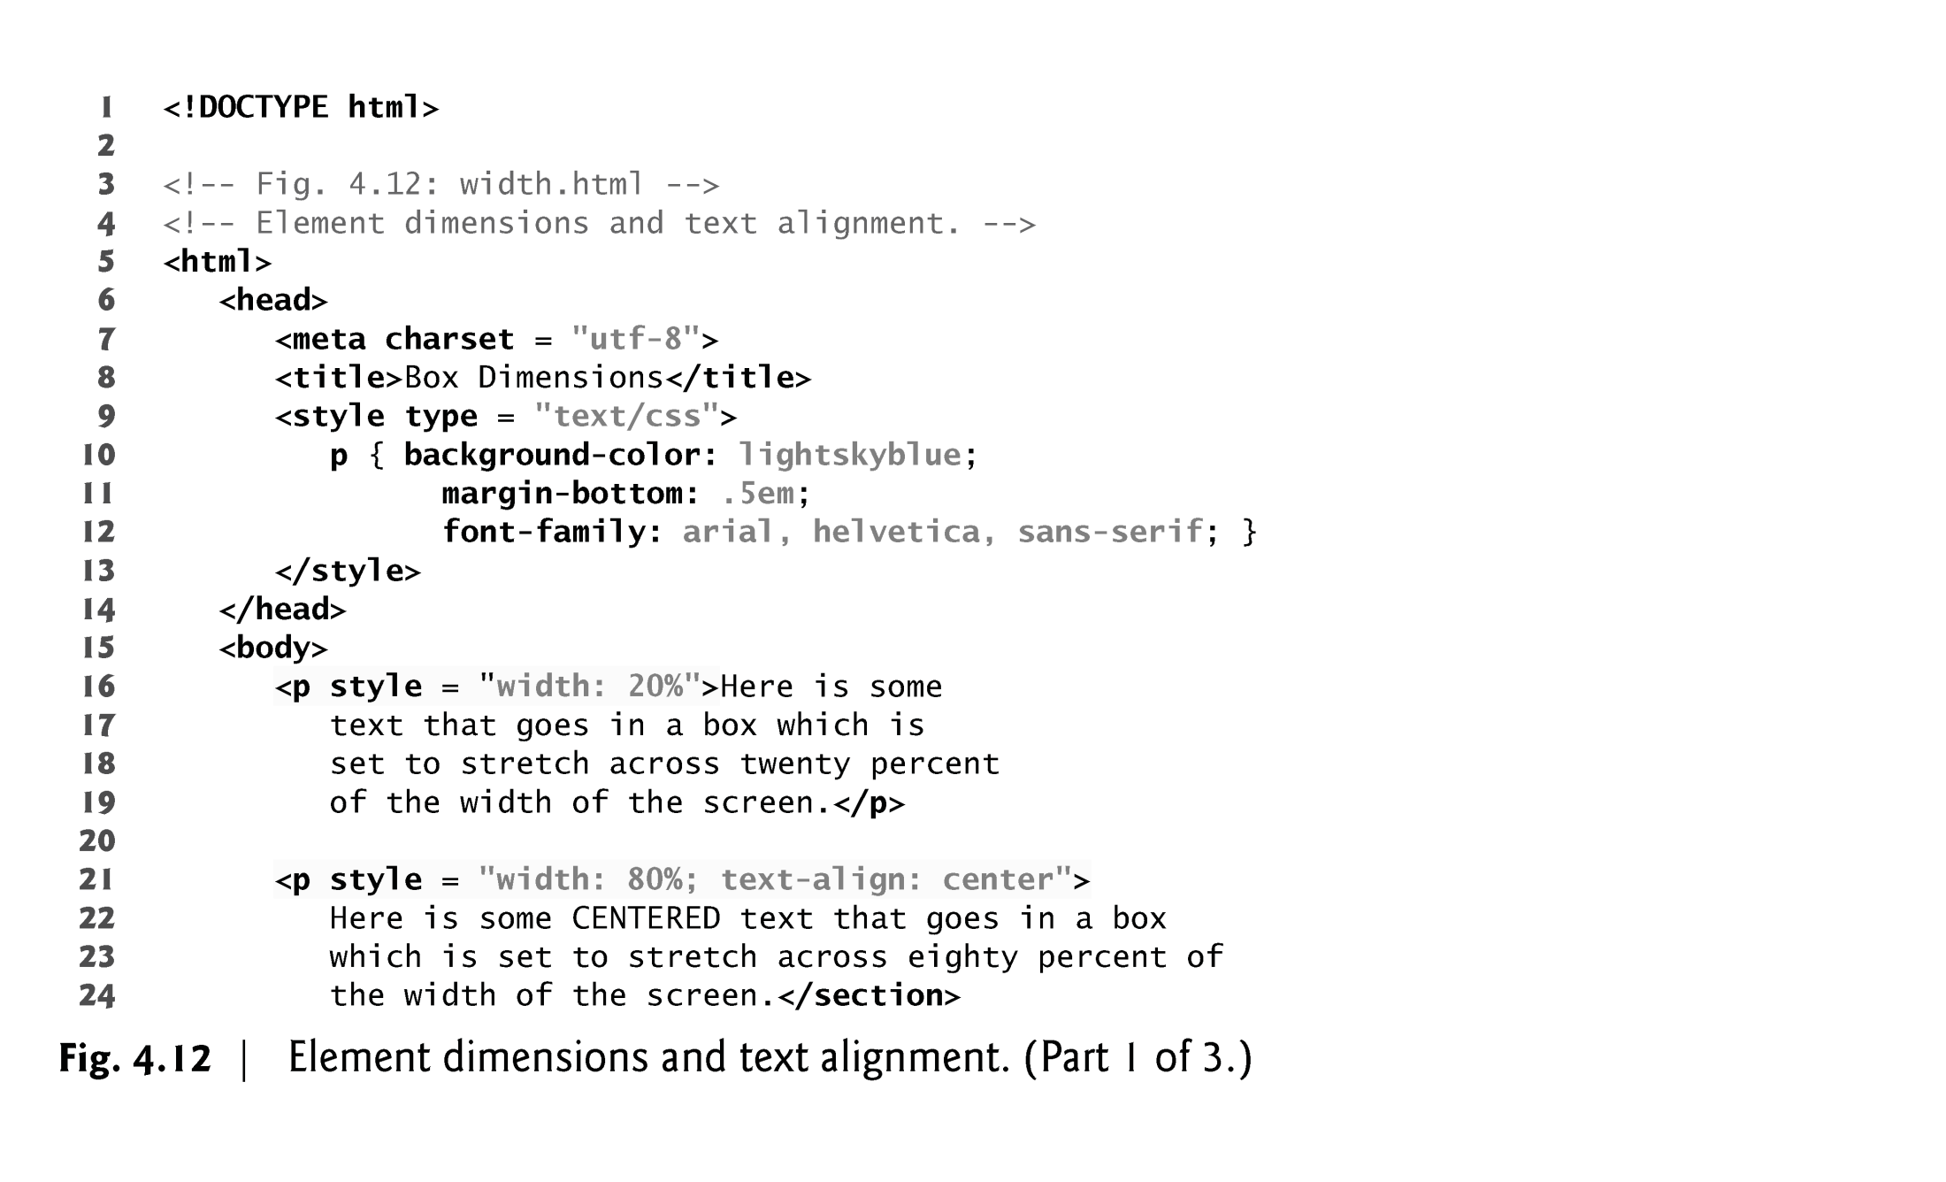

Slide 83
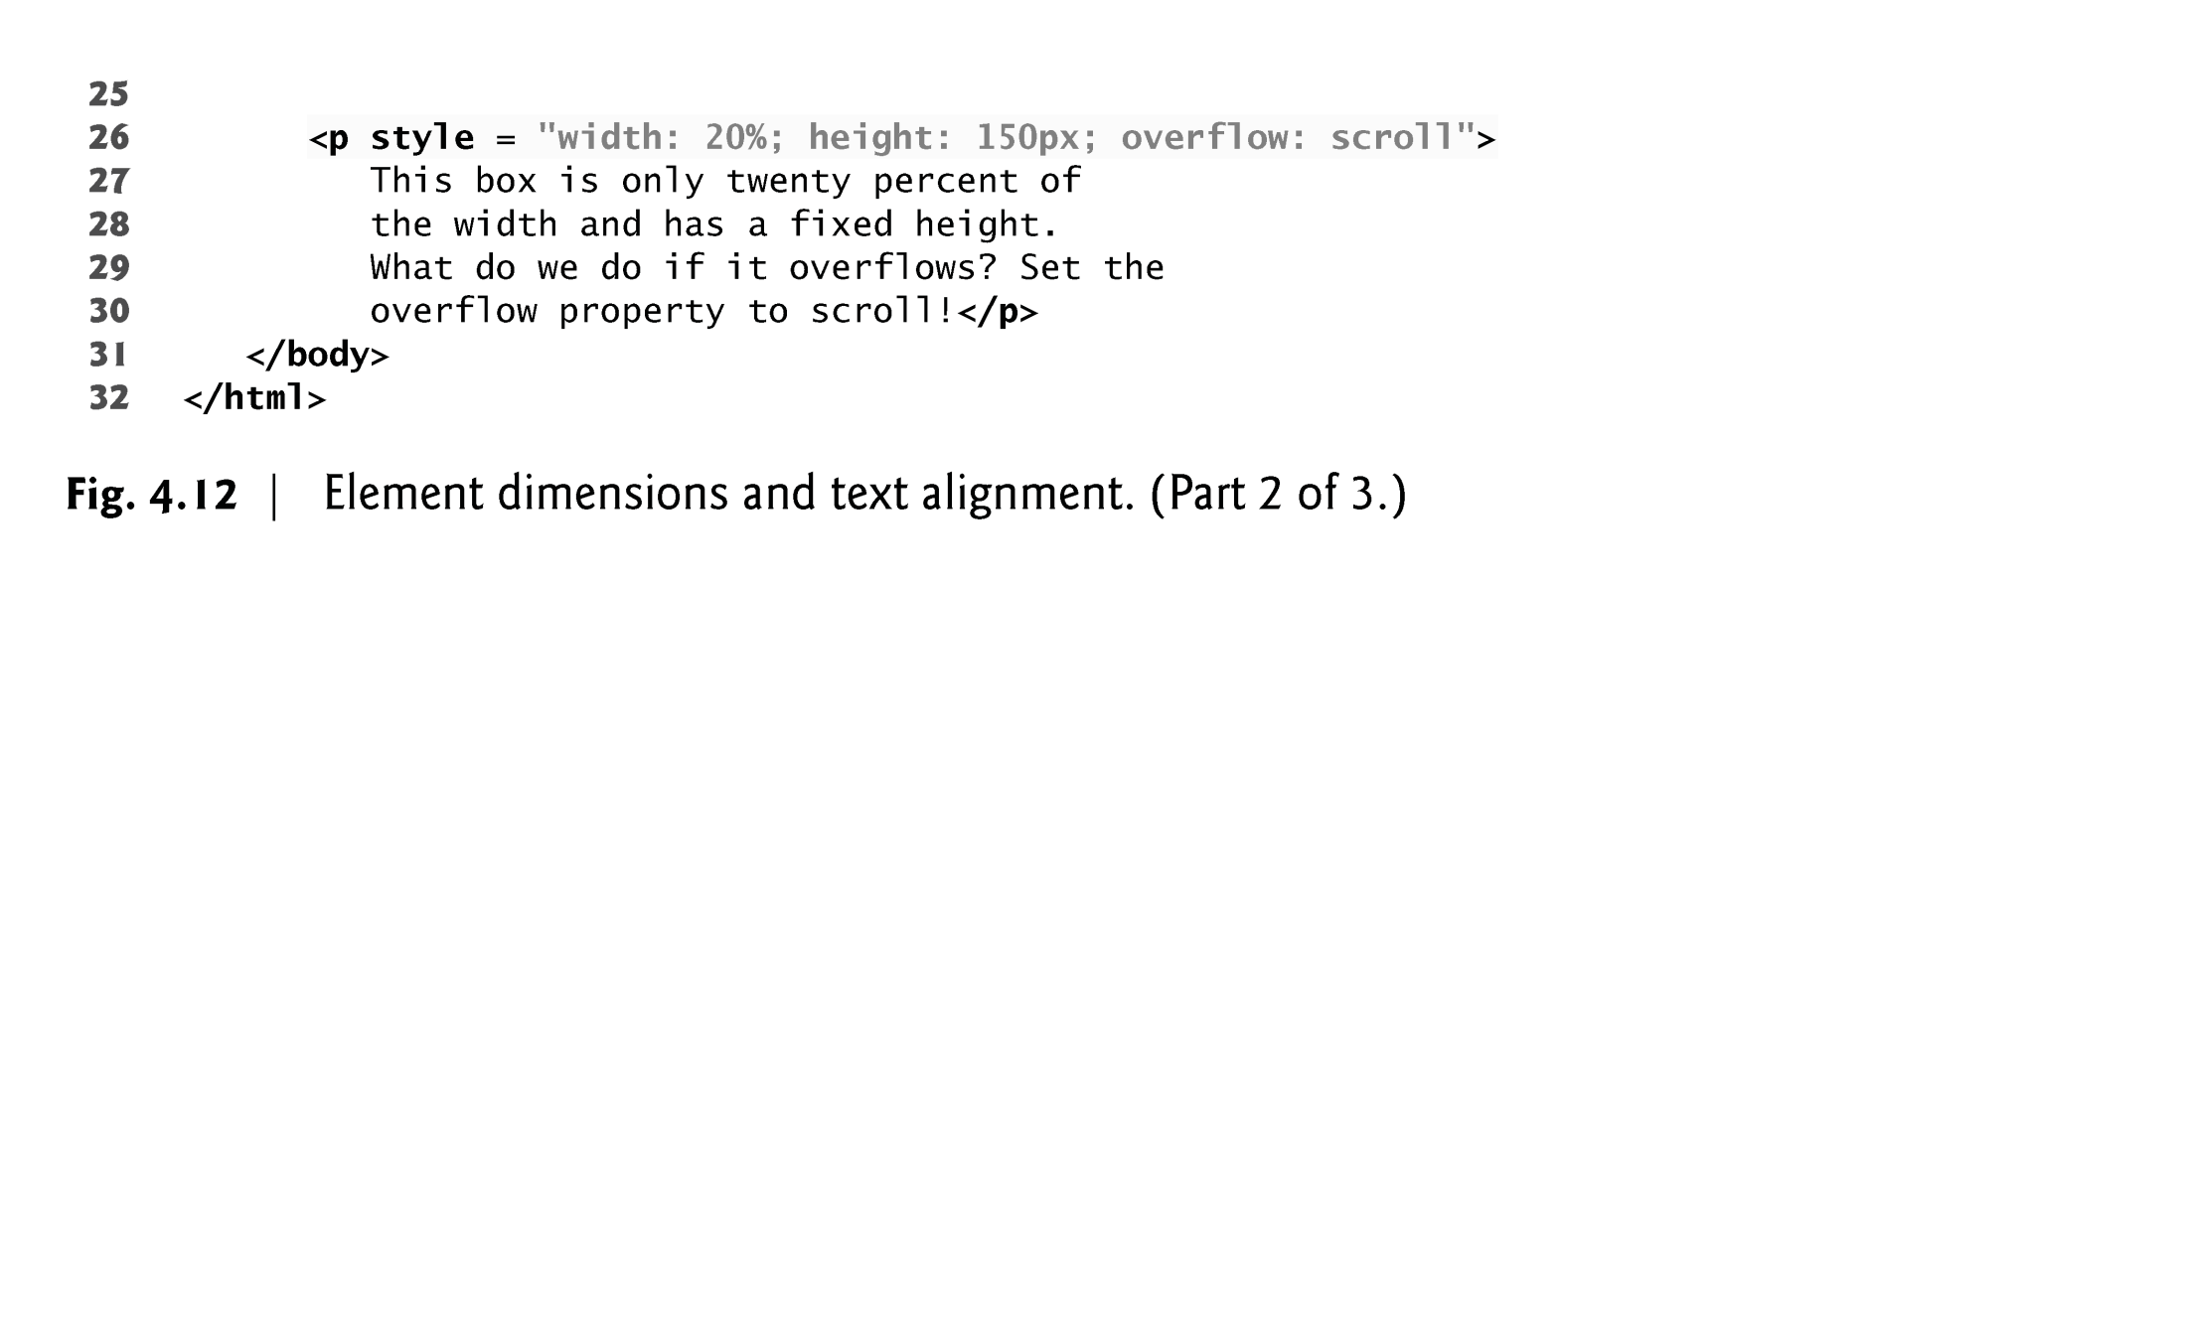

Slide 84
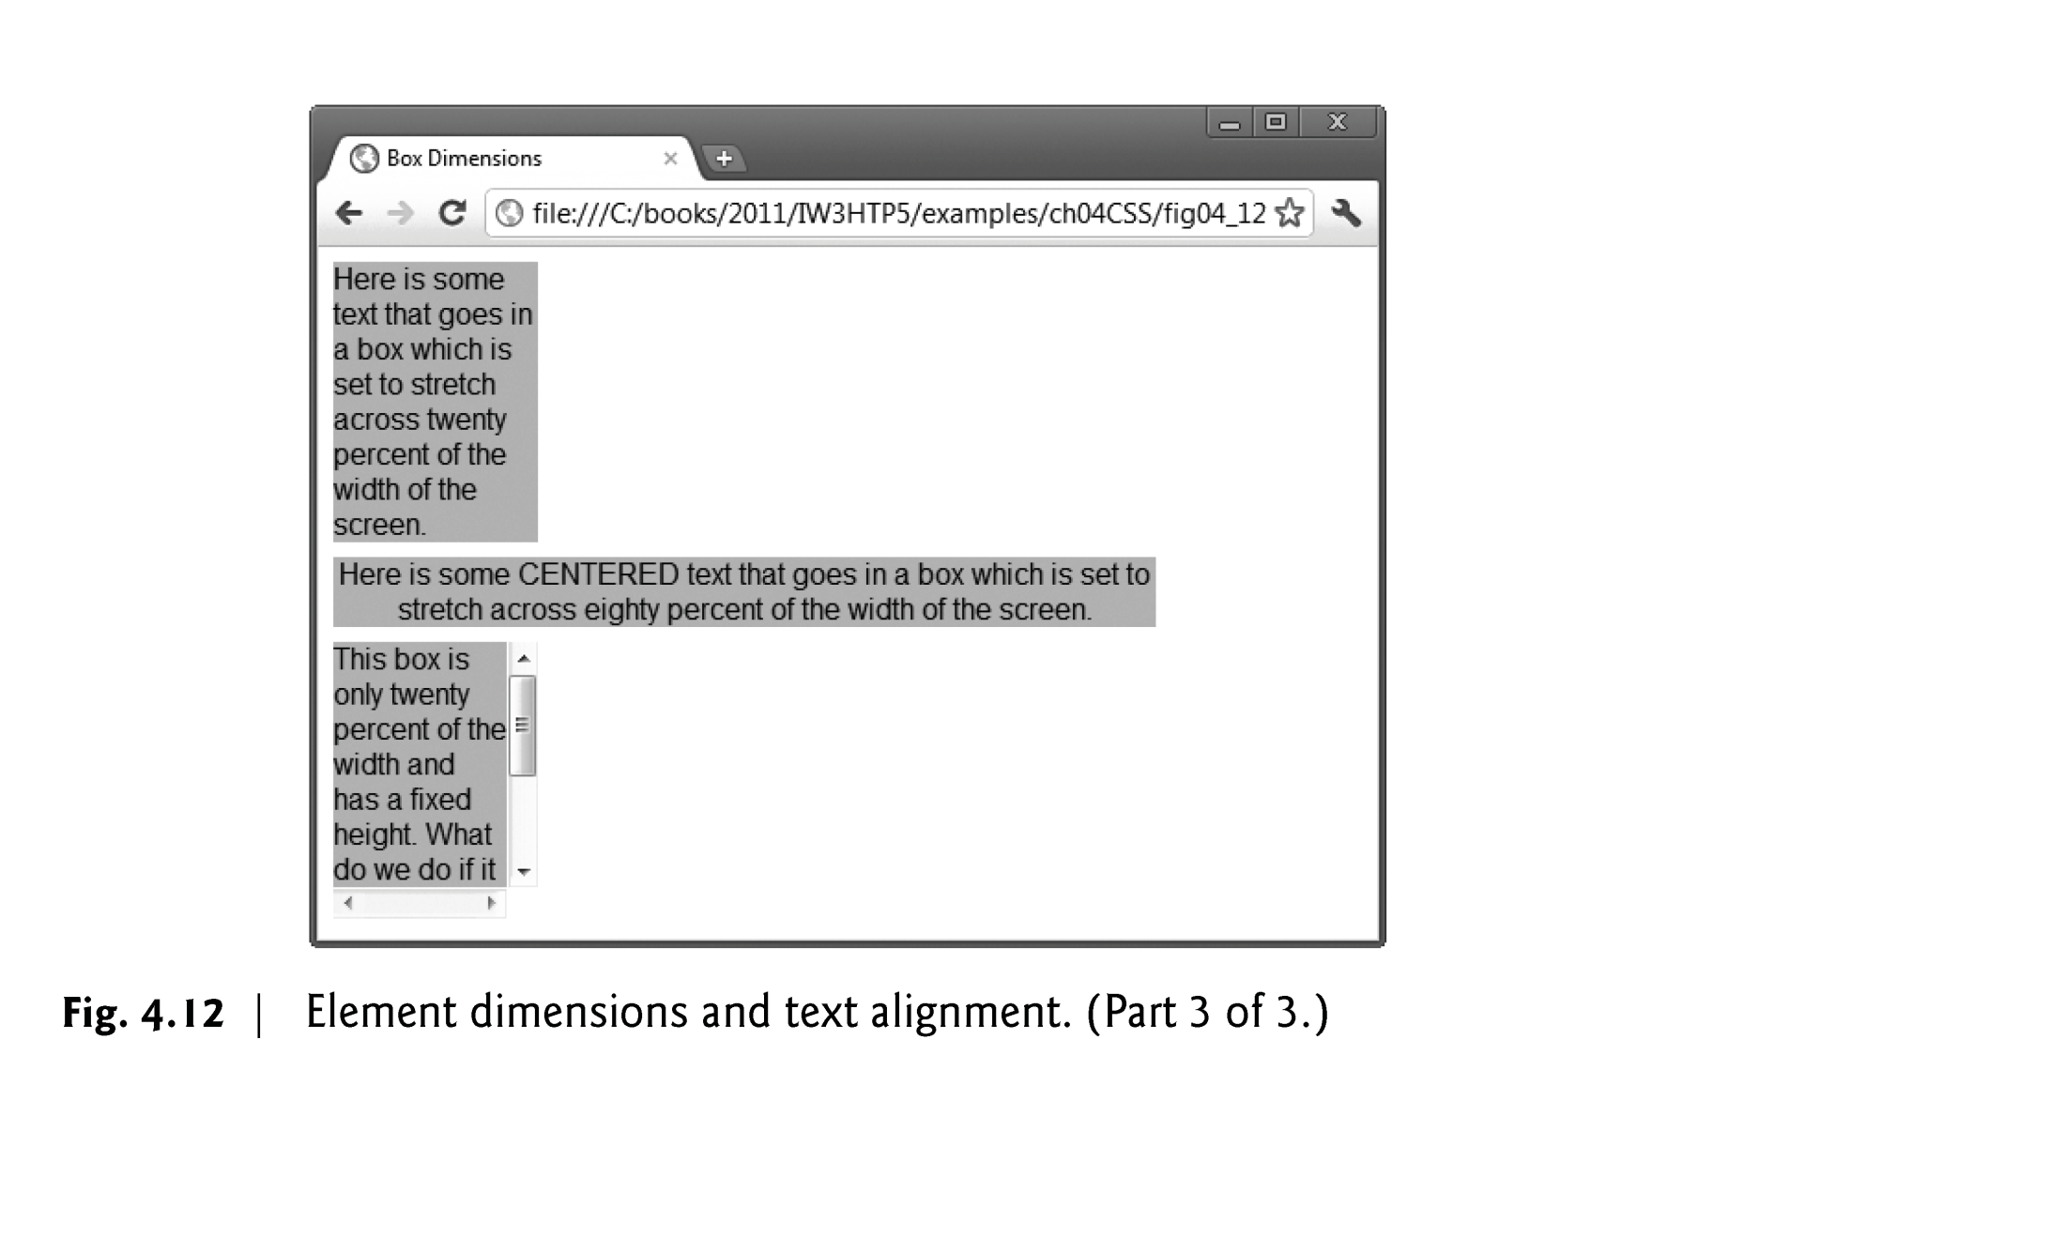

Slide 85
4.9 Element Dimensions
Specifying the width and height of an Element
Dimensions of elements on a page can be set with CSS by using properties height and width
Their values can be relative or absolute
text-align Property
Text in an element can be centered using text-align: center; other values for the text-align property are left and right

Slide 86
4.9 Element Dimensions (Cont.)
overflow Property and Scroll Bars
Problem with setting both vertical and horizontal dimensions of an element
Content might sometimes exceed the set boundaries, in which case the element must be made large enough for all the content to fit
Can set the overflow property to scroll, which adds scroll bars if the text overflows the boundaries set for it

Slide 87
4.10 Box Model and Text Flow
Block-level HTML5 elements have a virtual box drawn around them based on the box model
When the browser renders an element using the box model, the content is surrounded by padding, a margin and a border.
Padding
The padding property determines the distance between the content inside an element and the edge of the element
Padding be set for each side of the box by using padding-top, padding-right, padding-left and padding-bottom
Margin
Determines the distance between the element’s edge and any outside text
Margins for individual sides of an element can be specified by using margin-top, margin-right, margin-left and margin-bottom

Slide 88
4.10 Box Model and Text Flow (Cont.)
Border
The border is controlled using the properties:
border-width
May be set to any of the CSS lengths or to the predefined value of thin, medium or thick
border-color
Sets the color used for the border
border-style
Options are: none, hidden, dotted, dashed, solid, double, groove, ridge, inset and outset

Slide 89
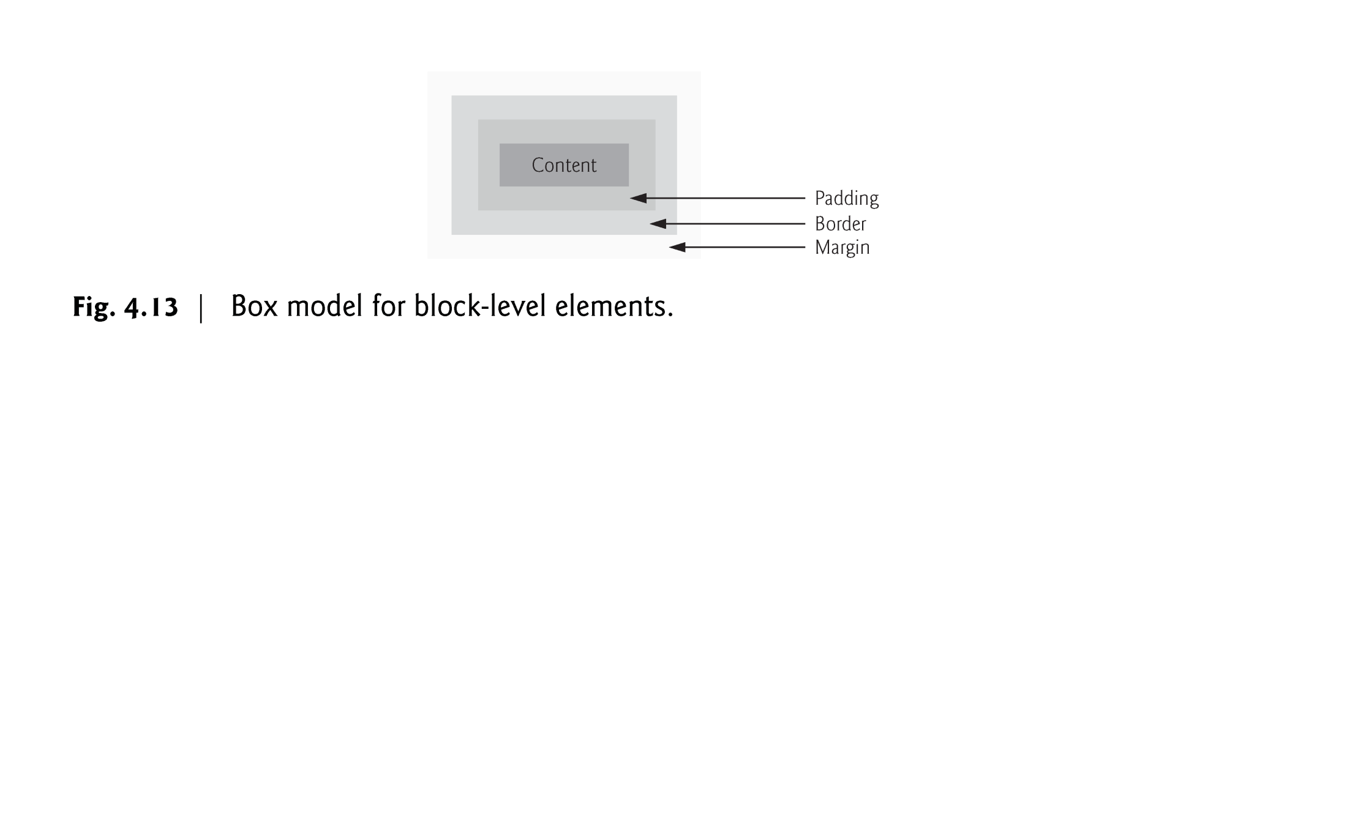

Slide 90
4.10 Box Model and Text Flow (Cont.)
CSS controls the border using three properties: border-width, border-color and border-style.
We illustrate these properties in Fig. 4.14.

Slide 91
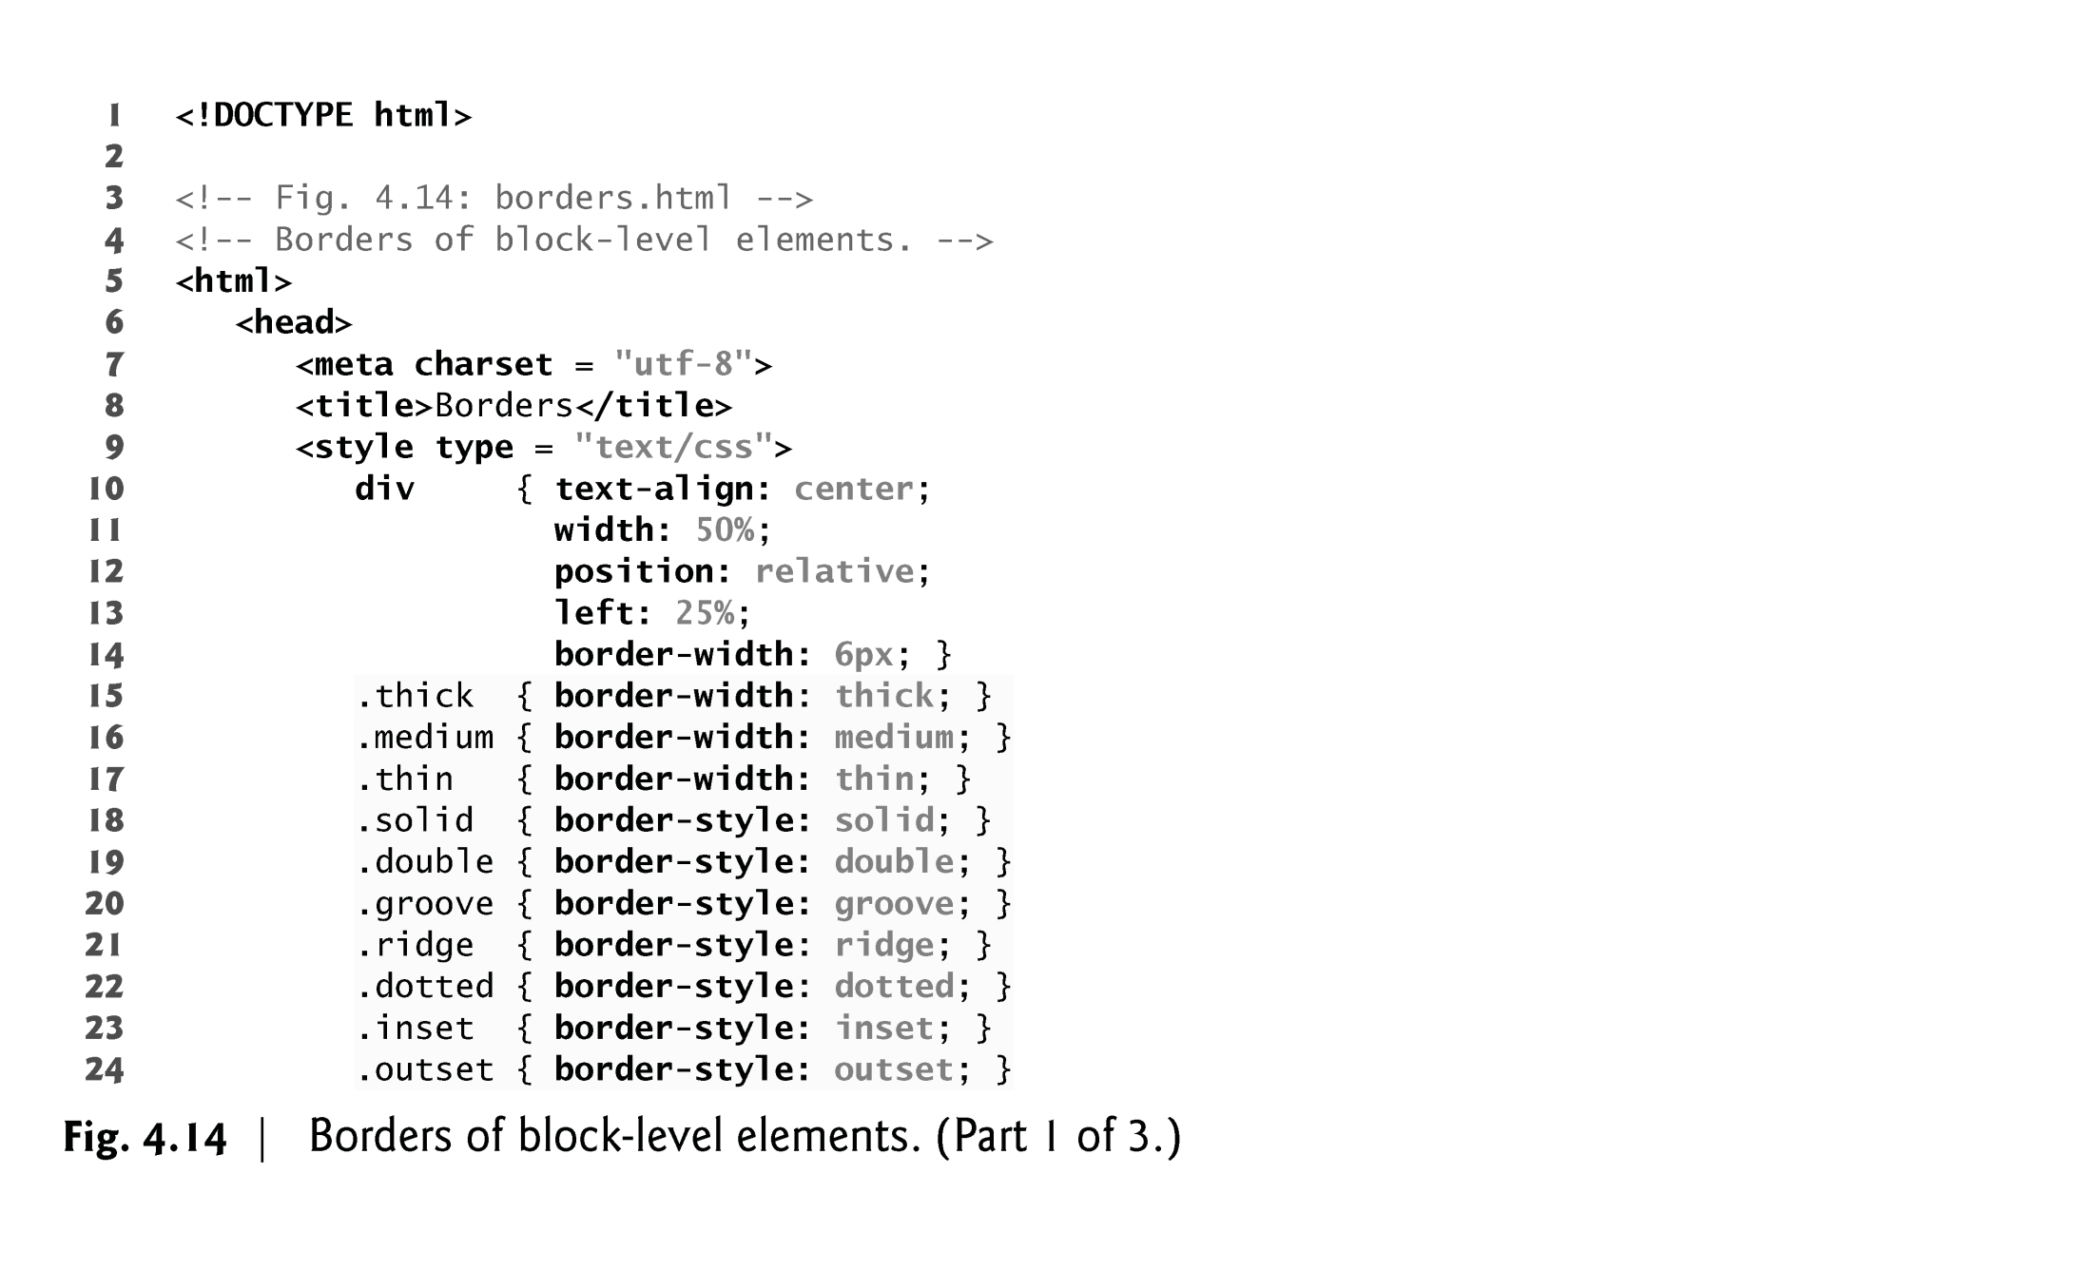

Slide 92
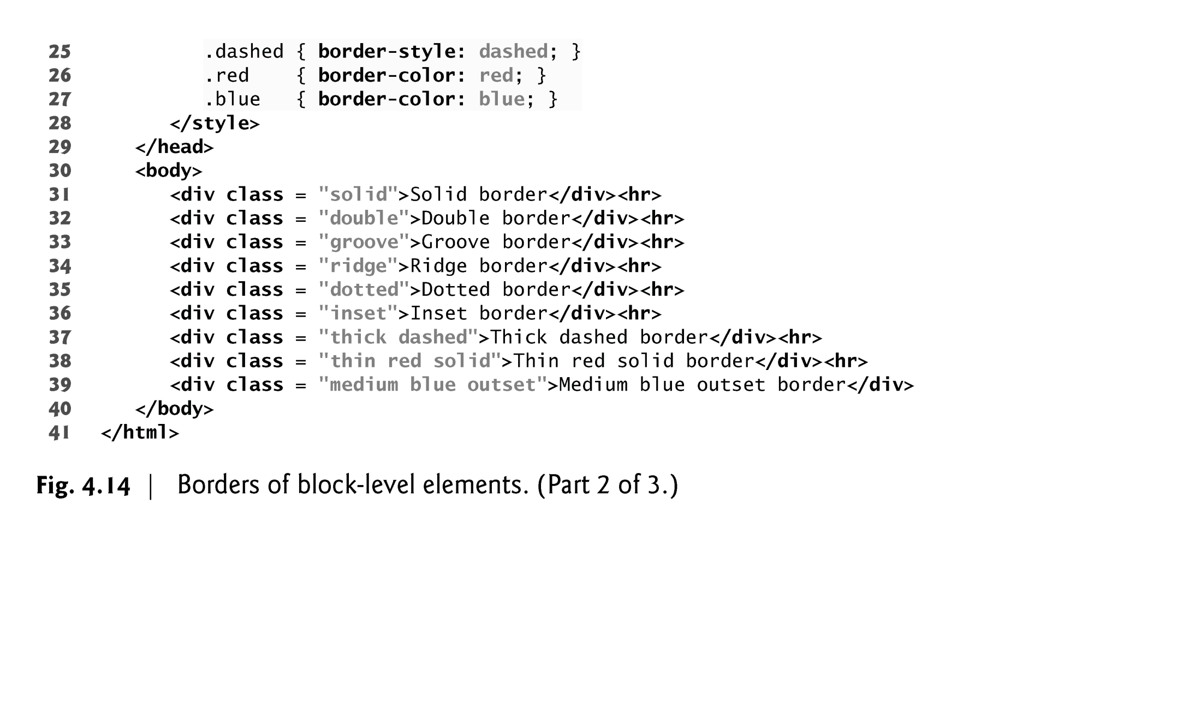

Slide 93
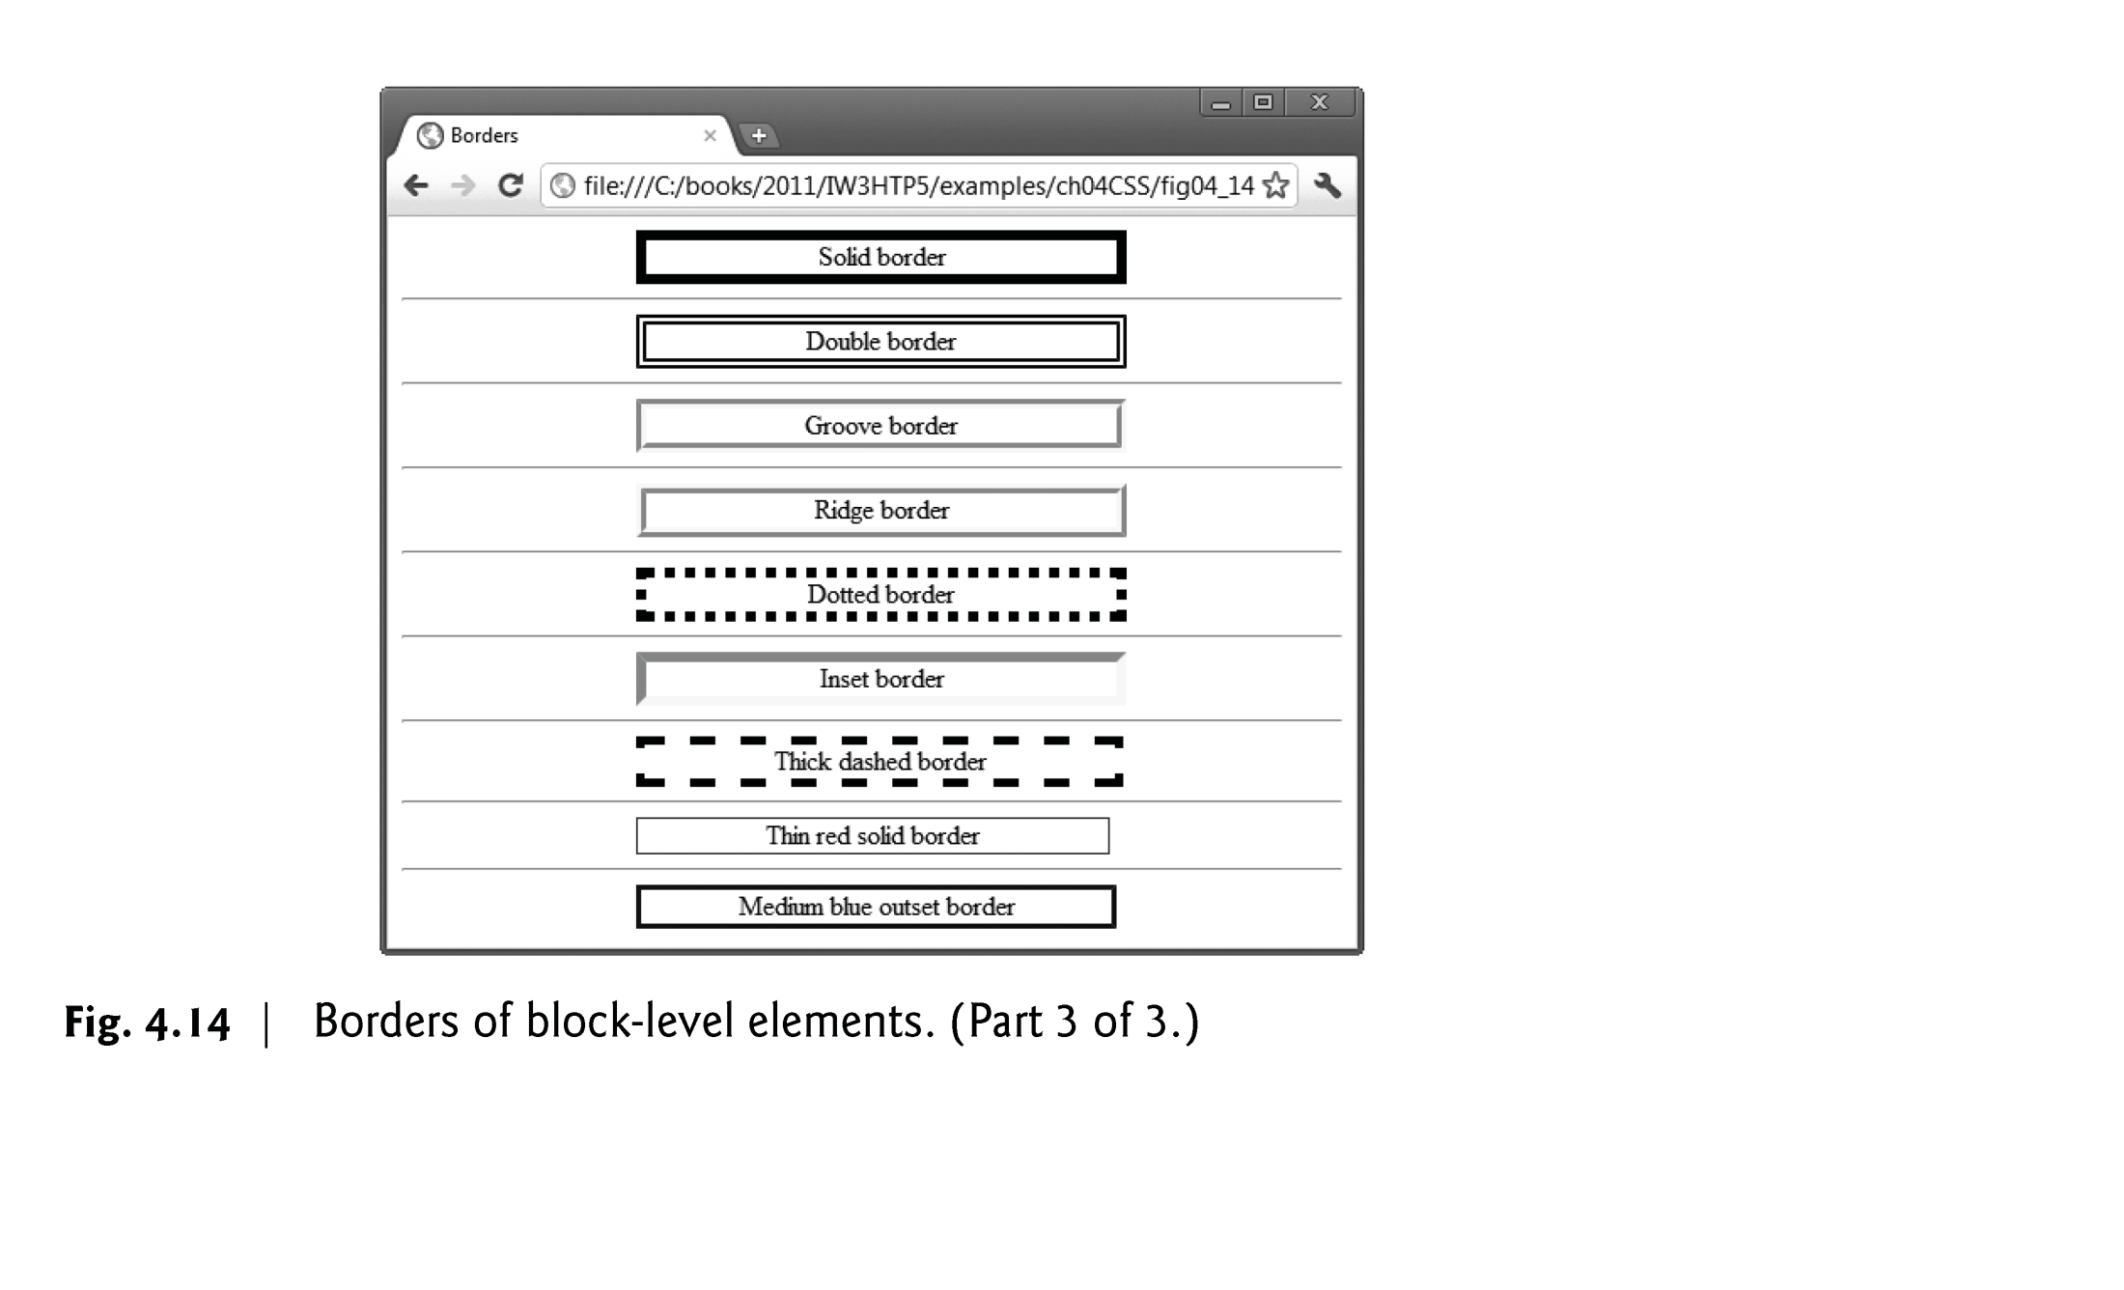

Slide 94
4.10 Box Model and Text Flow (Cont.)
Floating Elements
Floating allows you to move an element to one side of the screen; other content in the document then flows around the floated element.
Figure 4.15 demonstrates how floating elements and the box model can be used to control the layout of an entire page.

Slide 95
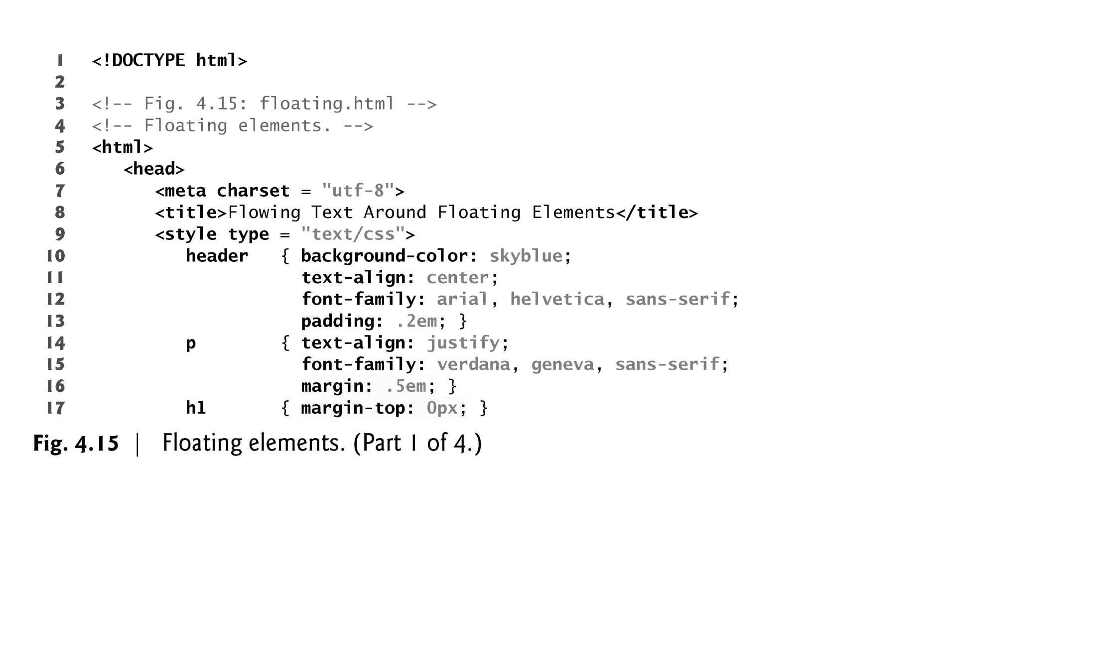

Slide 96
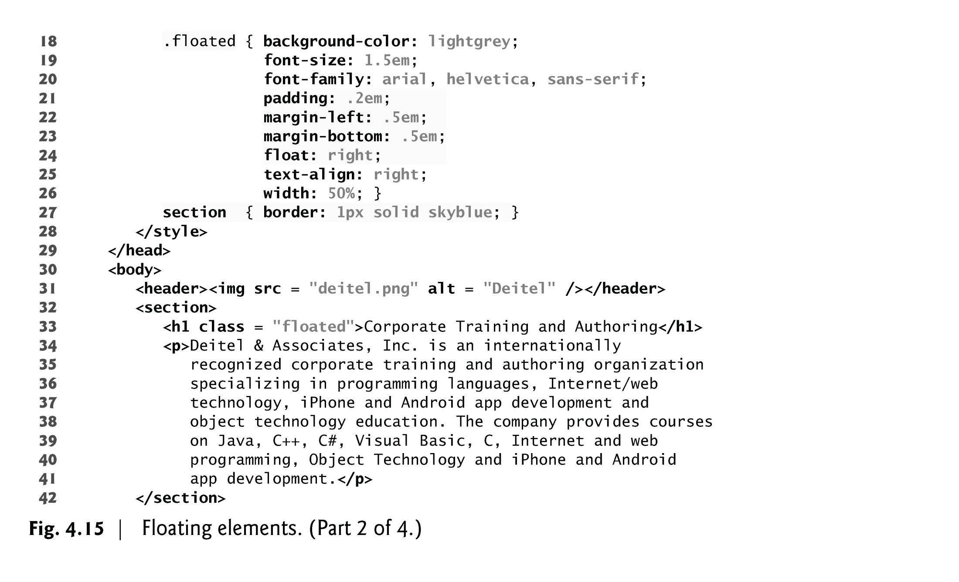

Slide 97
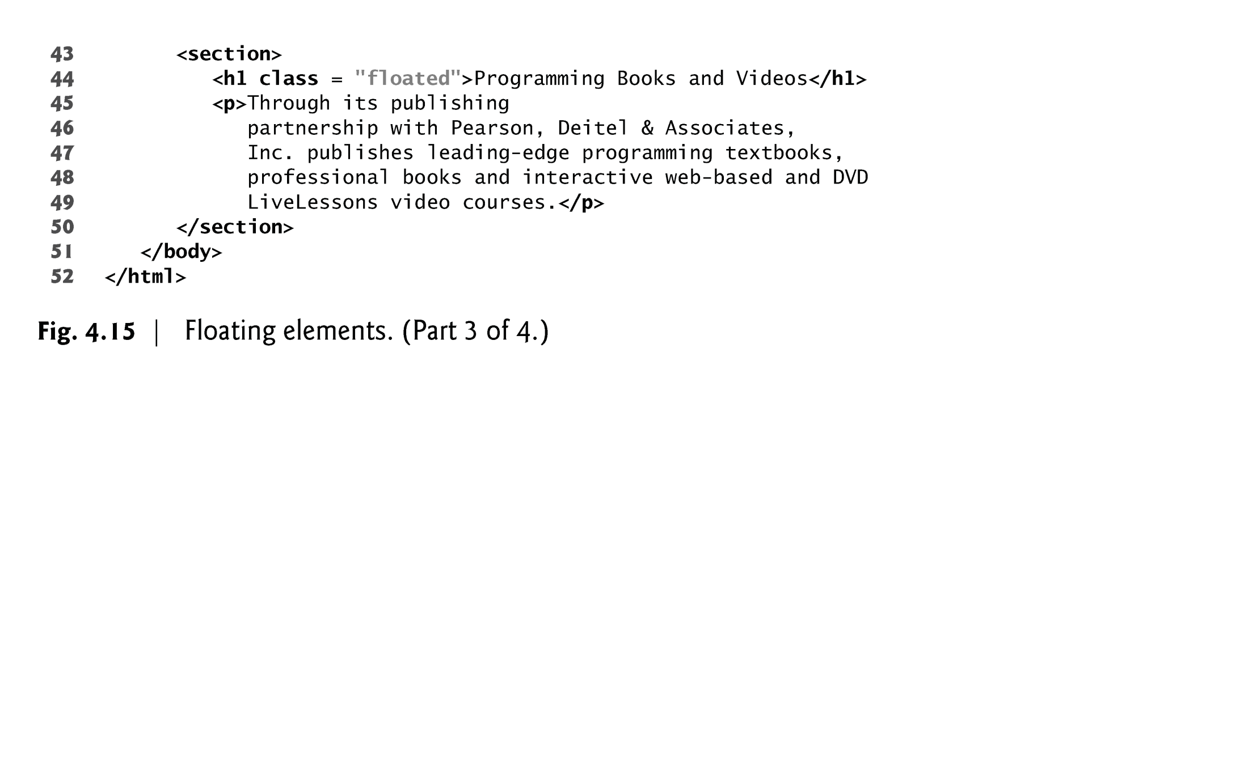

Slide 98
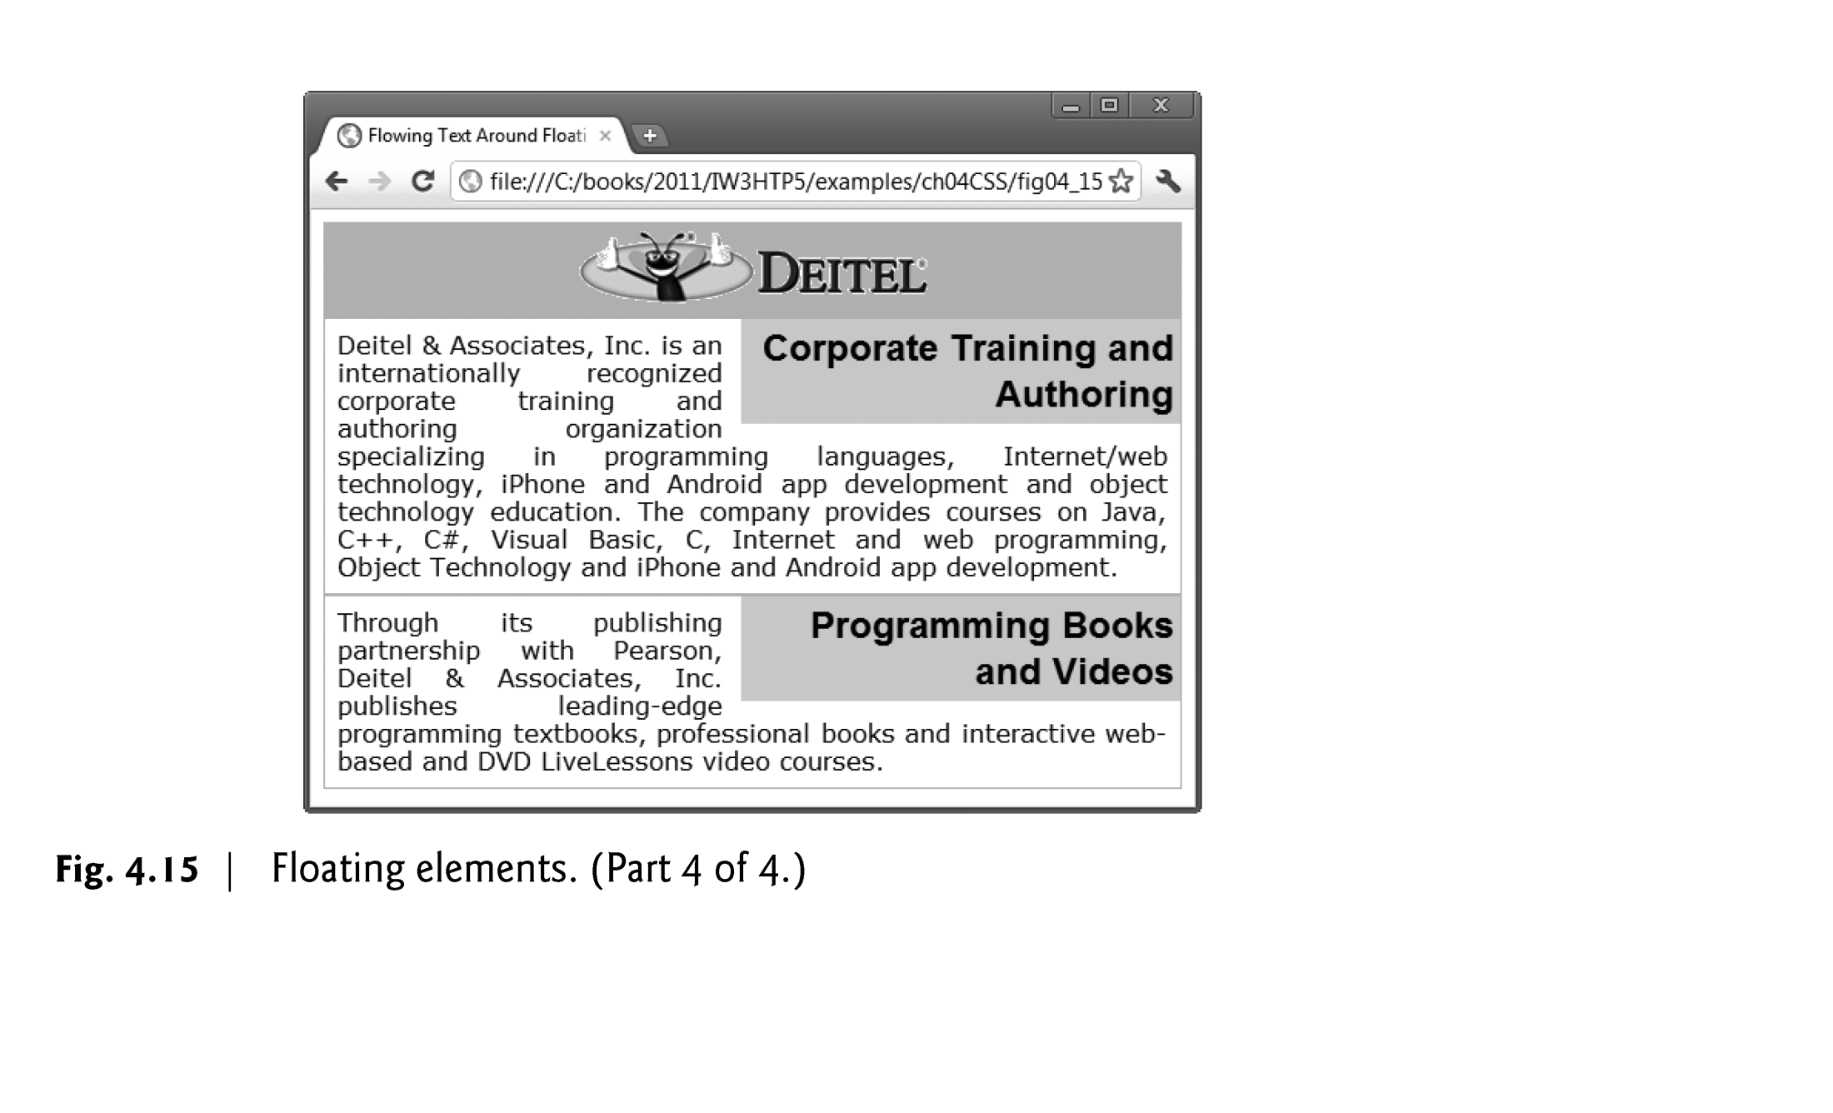

Slide 99
4.10 Box Model and Text Flow (Cont.)
margin and padding Properties
The margin property sets the space between the outside of an element’s border and all other content on the page.
The padding property determines the distance between the content inside an element and the inside of the element’s border.
Margins for individual sides of an element can be specified by using the properties margin-top, margin-right, margin-left and margin-bottom.
Padding can be specified in the same way, using padding-top, padding-right, padding-left and padding-bottom.

Slide 100
4.11 Media Types and Media Queries
CSS media types
allow you to decide what a page should look like depending on the kind of media being used to display the page
Most common media type for a web page is the screen media type, which is a standard computer screen

Slide 101
4.11 Media Types and Media Queries (Cont.)
A block of styles that applies to all media types is declared by @media all and enclosed in curly braces
To create a block of styles that apply to a single media type such as print, use @media print and enclose the style rules in curly braces

Slide 102
4.11 Media Types and Media Queries (Cont.)
Other media types in CSS include:
handheld
Designed for mobile Internet devices
braille
For machines that can read or print web pages in braille
speech
Allow the programmer to give a speech-synthesizing web browser more information about the content of the web page
print
Affects a web page’s appearance when it is printed

Slide 103
4.11 Media Types and Media Queries (Cont.)
Figure 4.16 gives a simple classic example that applies one set of styles when the document is viewed on all media (including screens) other than a printer, and another when the document is printed.
To see the difference, look at the screen captures below the paragraph or use the Print Preview feature in your browser if it has one.

Slide 104
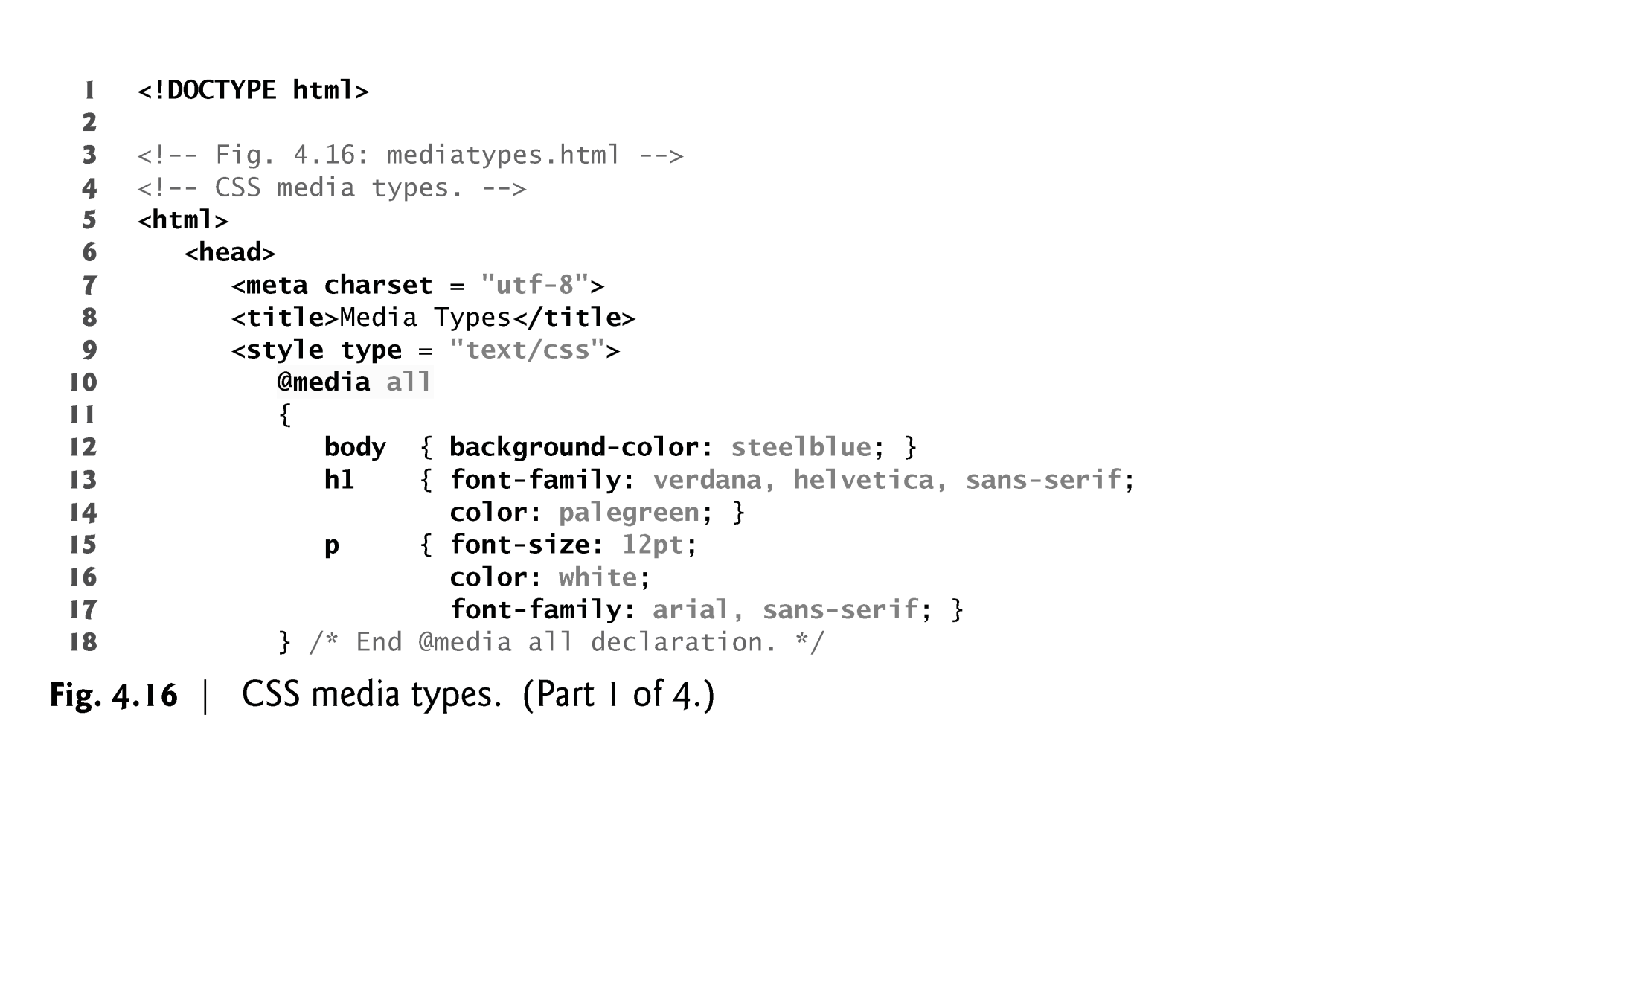

Slide 105
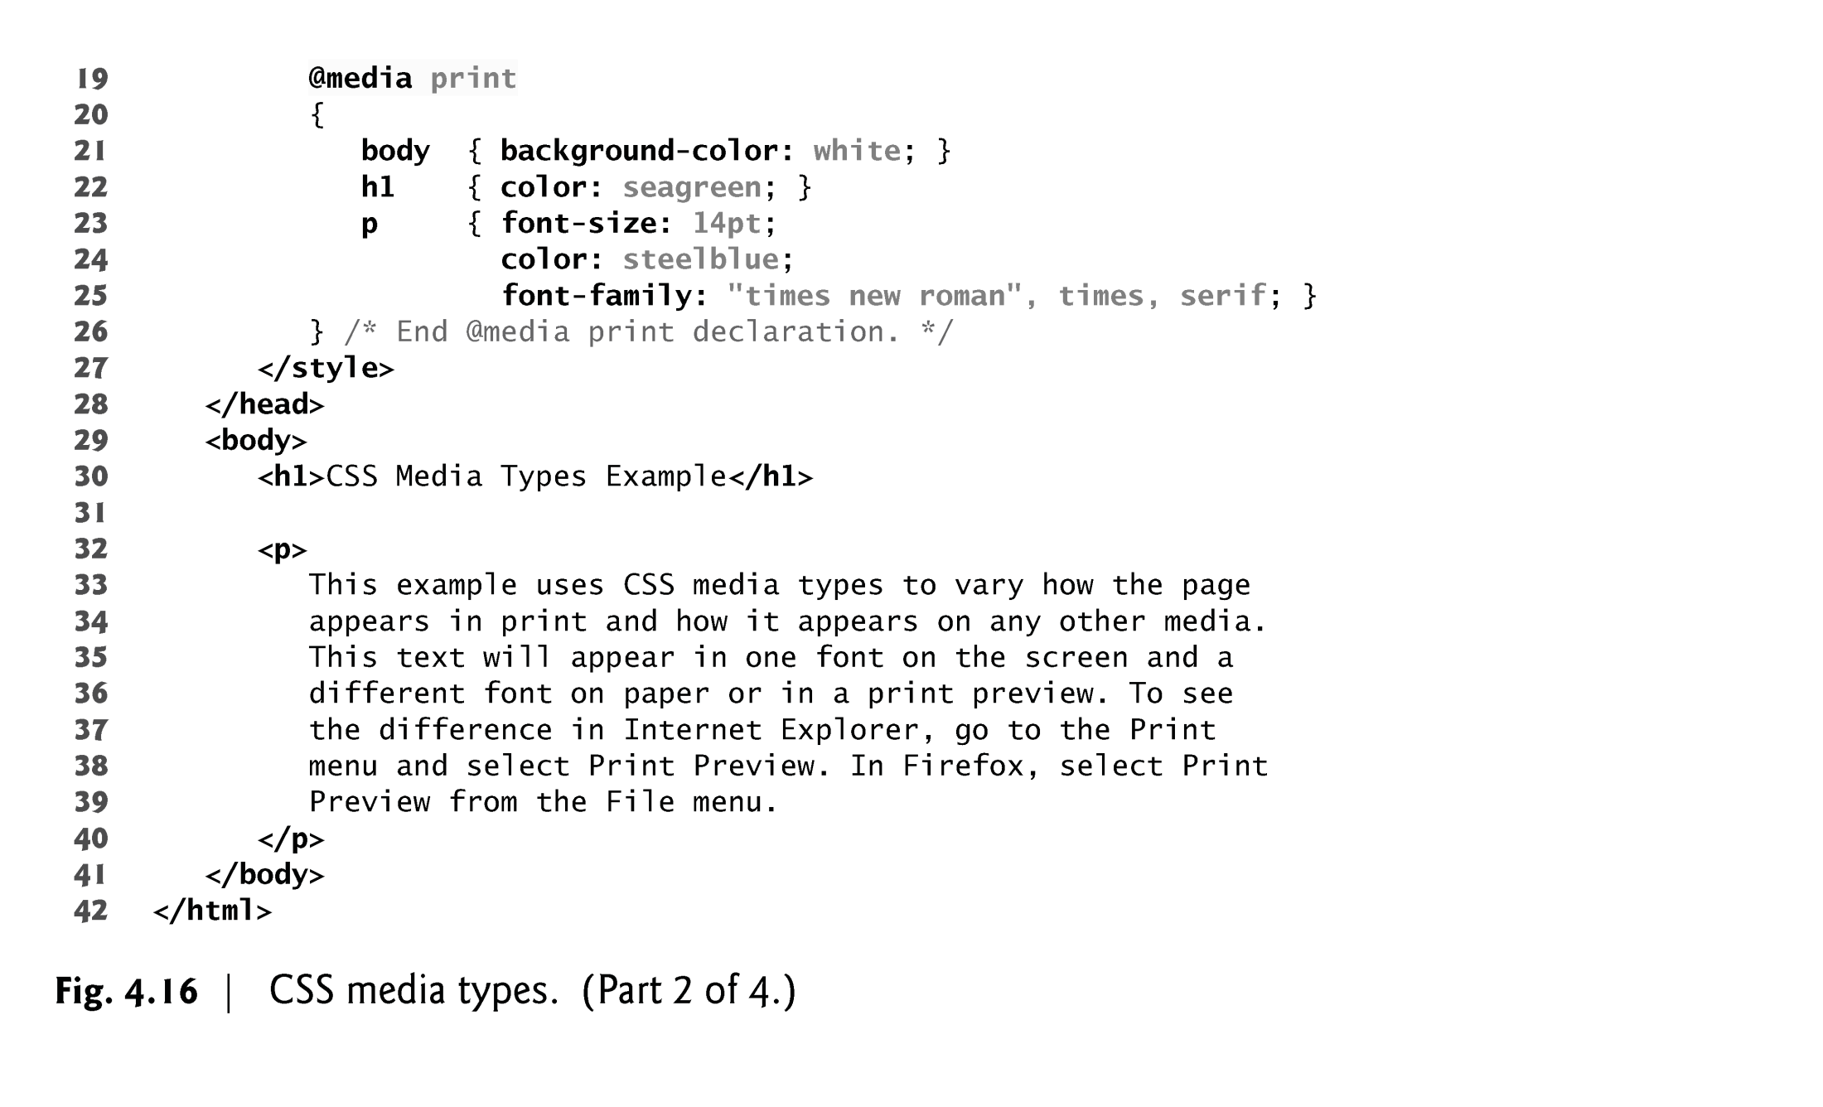

Slide 106
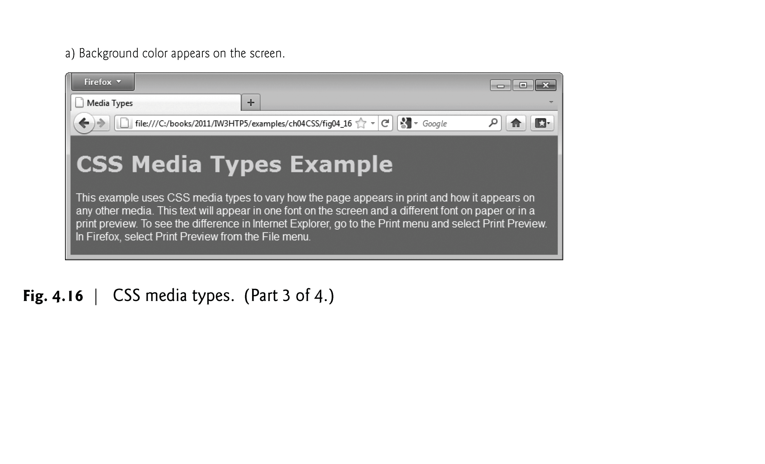

Slide 107
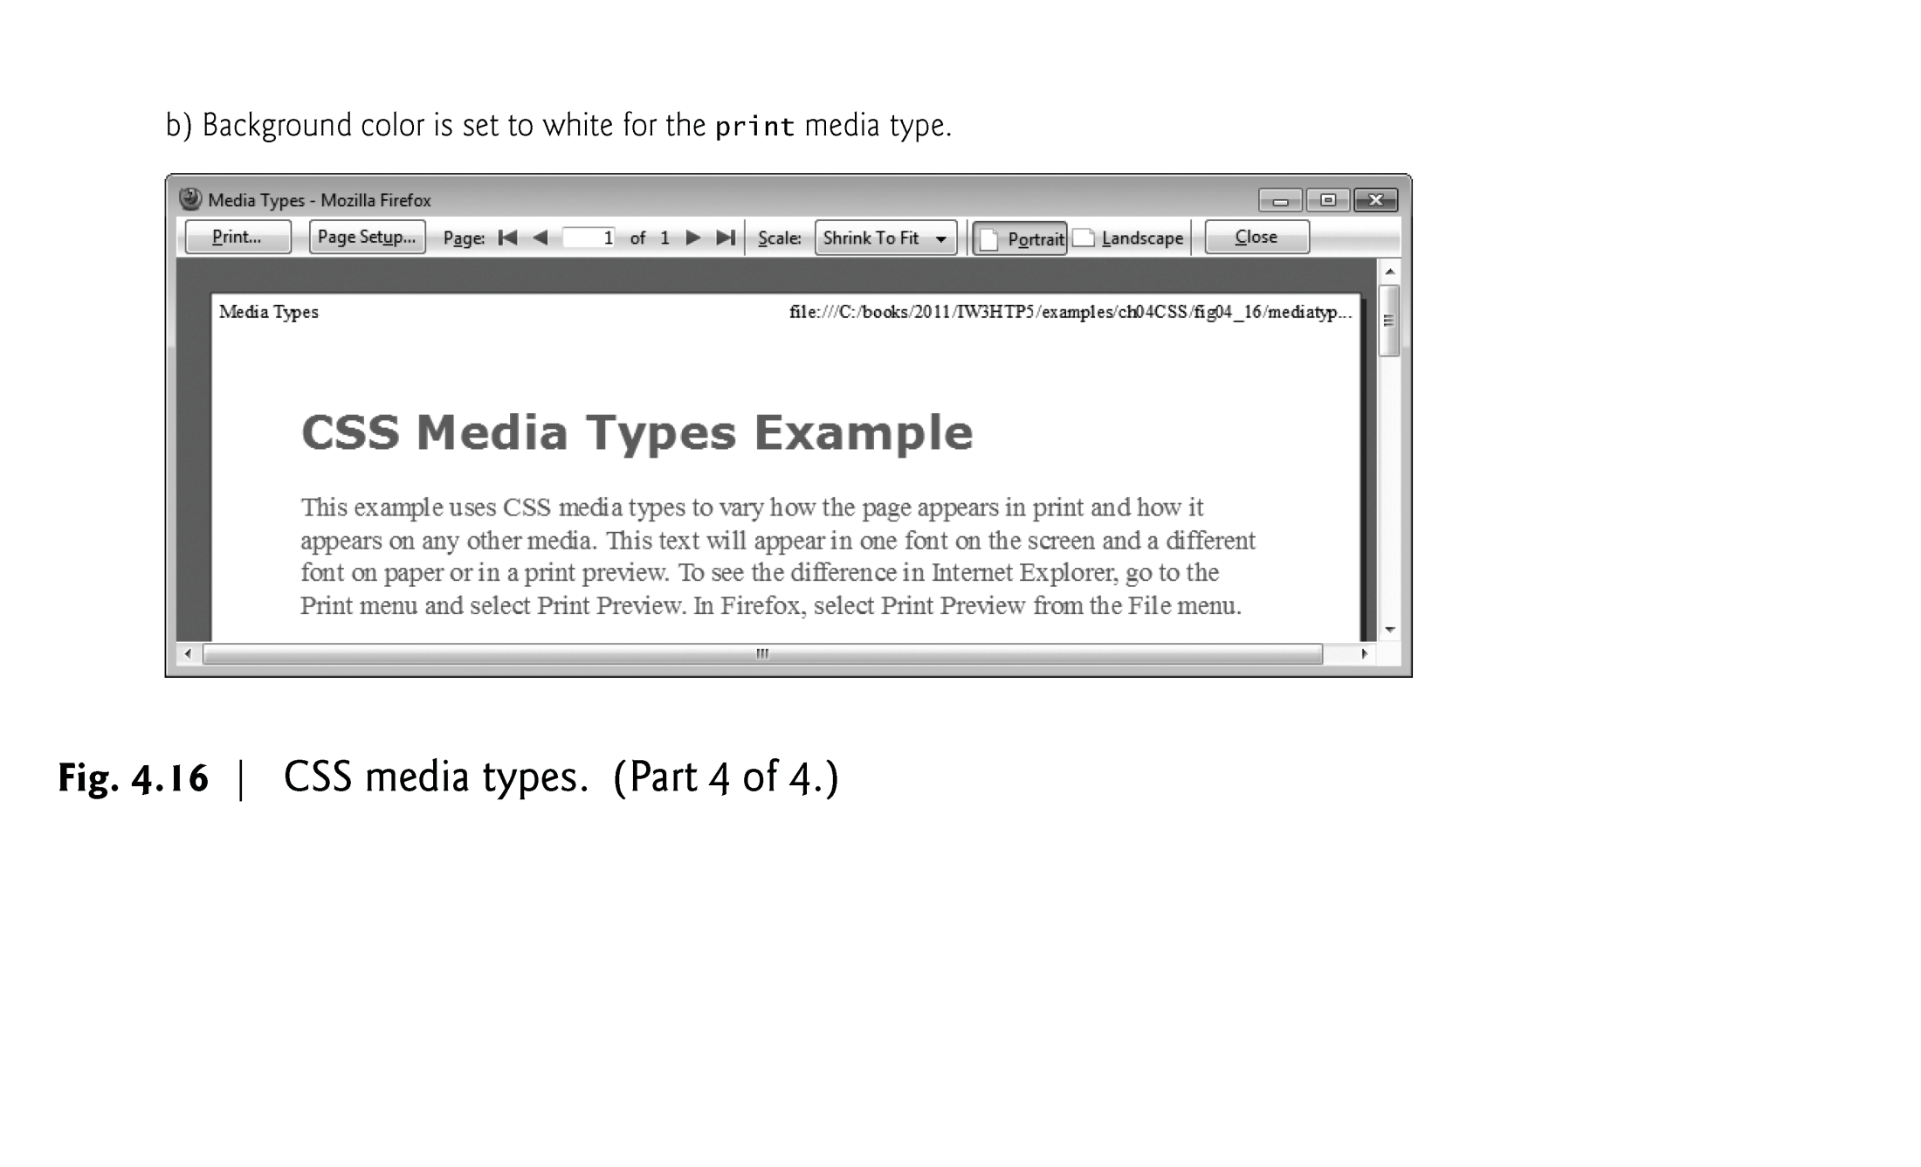

Slide 108
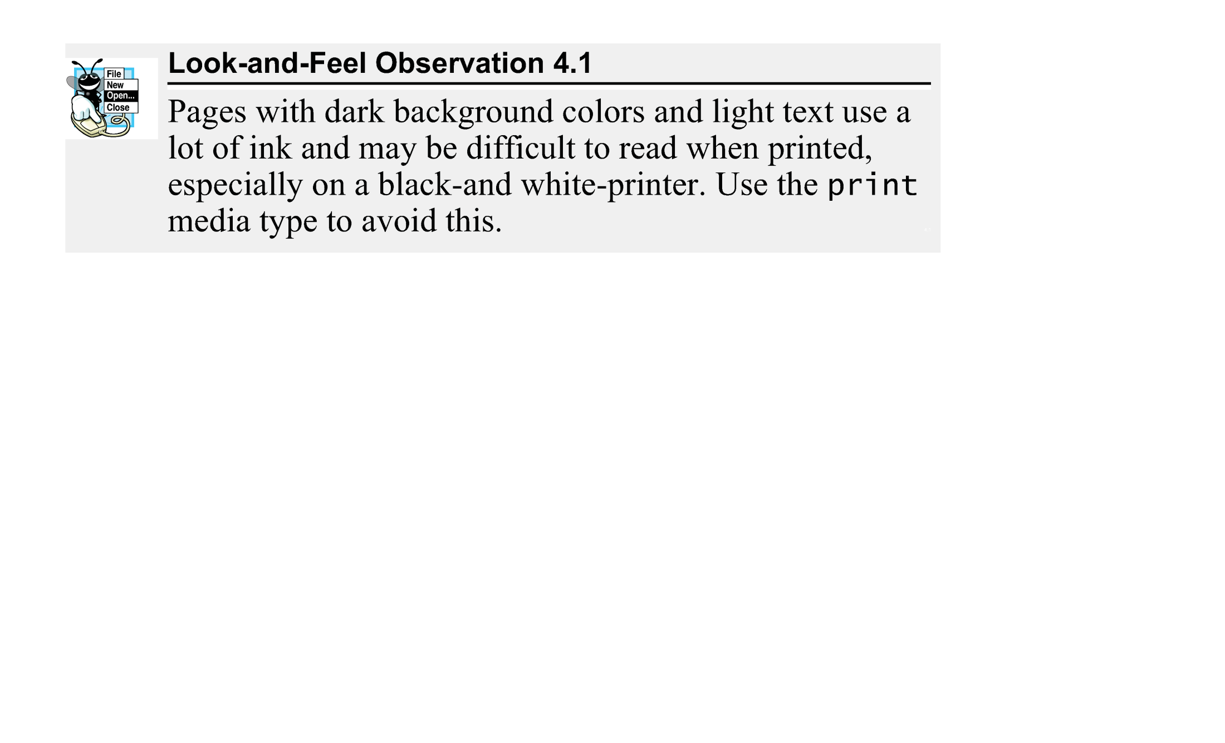

Slide 109
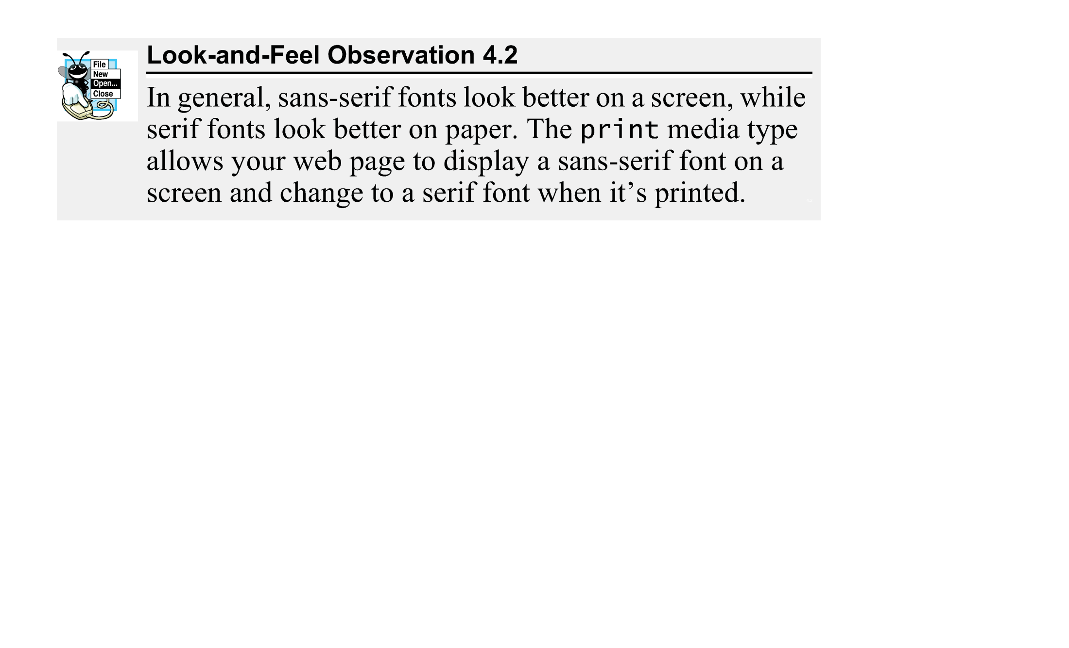

Slide 110
4.11 Media Types and Media Queries (Cont.)
Media Queries
Allow you to format your content to specific output devices.
Include a media type and expressions that check the media features of the output device.
Common media features include:
width—the width of the part of the screen on which the document is rendered, including any scrollbars
height—the height of the part of the screen on which the document is rendered, including any scrollbars
device-width—the width of the screen of the output device
device-height—the height of the screen of the output device
orientation—if the height is greater than the width, orientation is portrait, and if the width is greater than the height, orientation is landscape
aspect-ratio—the ratio of width to height
device-aspect-ratio—the ratio of device-width to device-height

Slide 111
4.12 Drop-Down Menus
:hover pseudoclass
used to apply styles to an element when the mouse cursor is over it
display property
allows a programmer to decide if an element is displayed as a block element, inline element, or is not rendered at all (none)

Slide 112
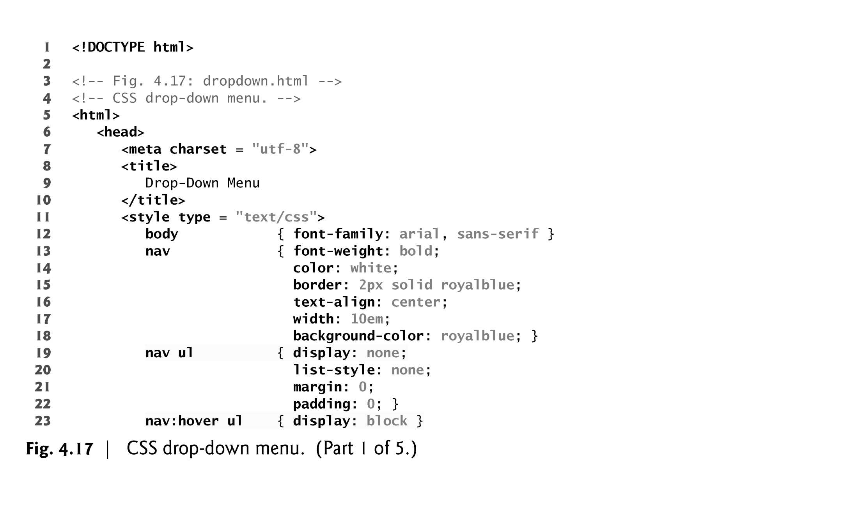

Slide 113
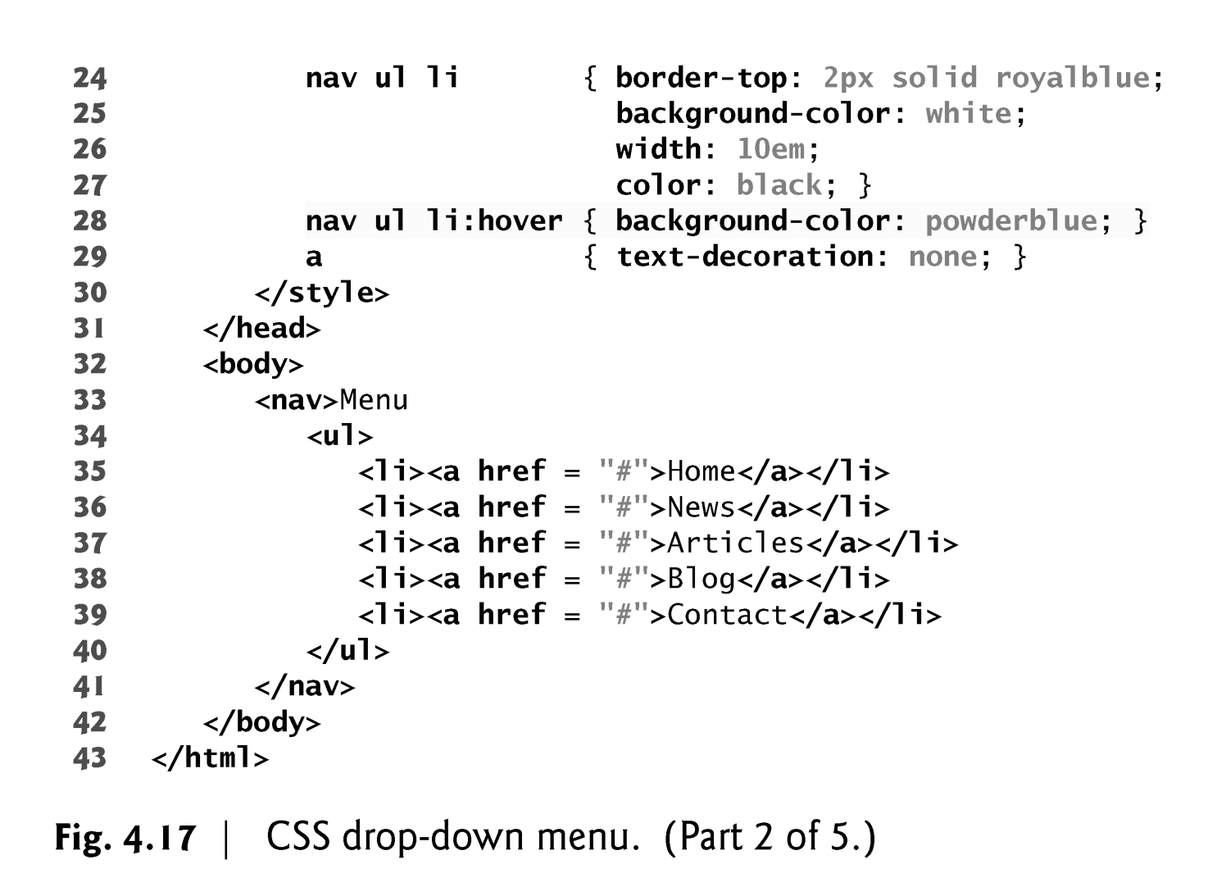

Slide 114
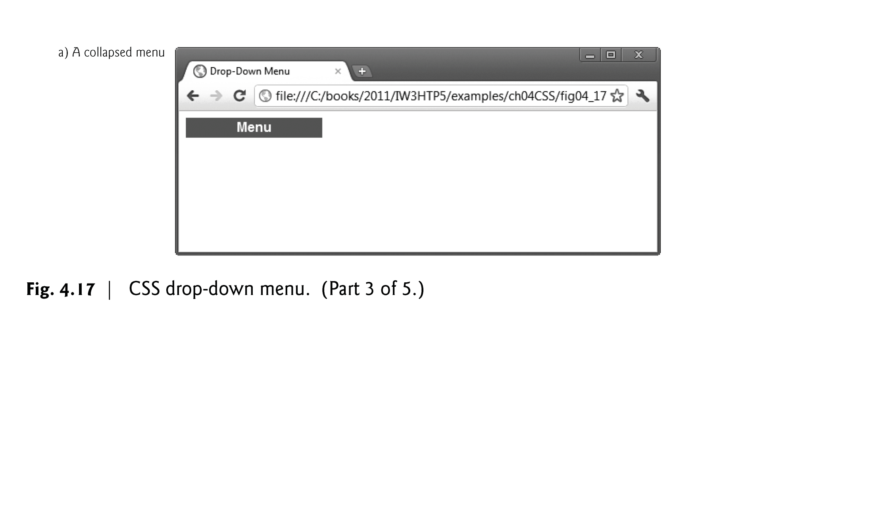

Slide 115
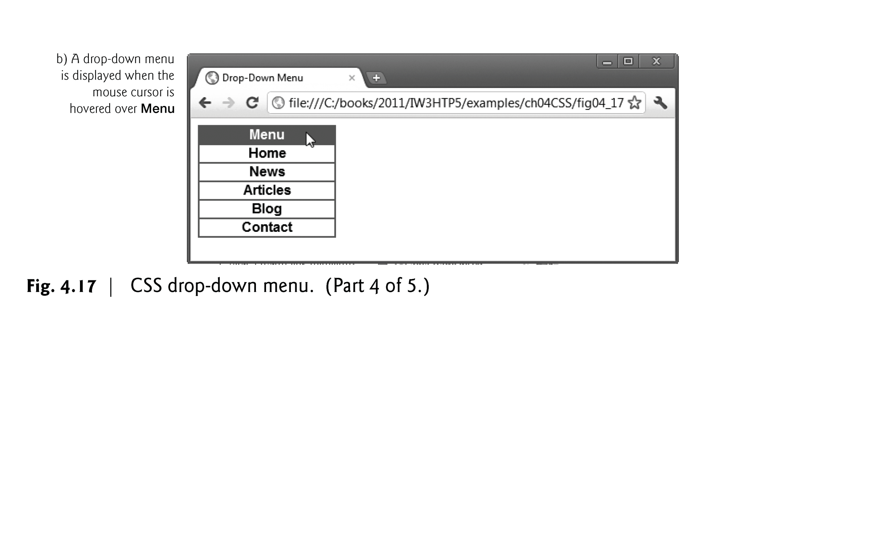

Slide 116
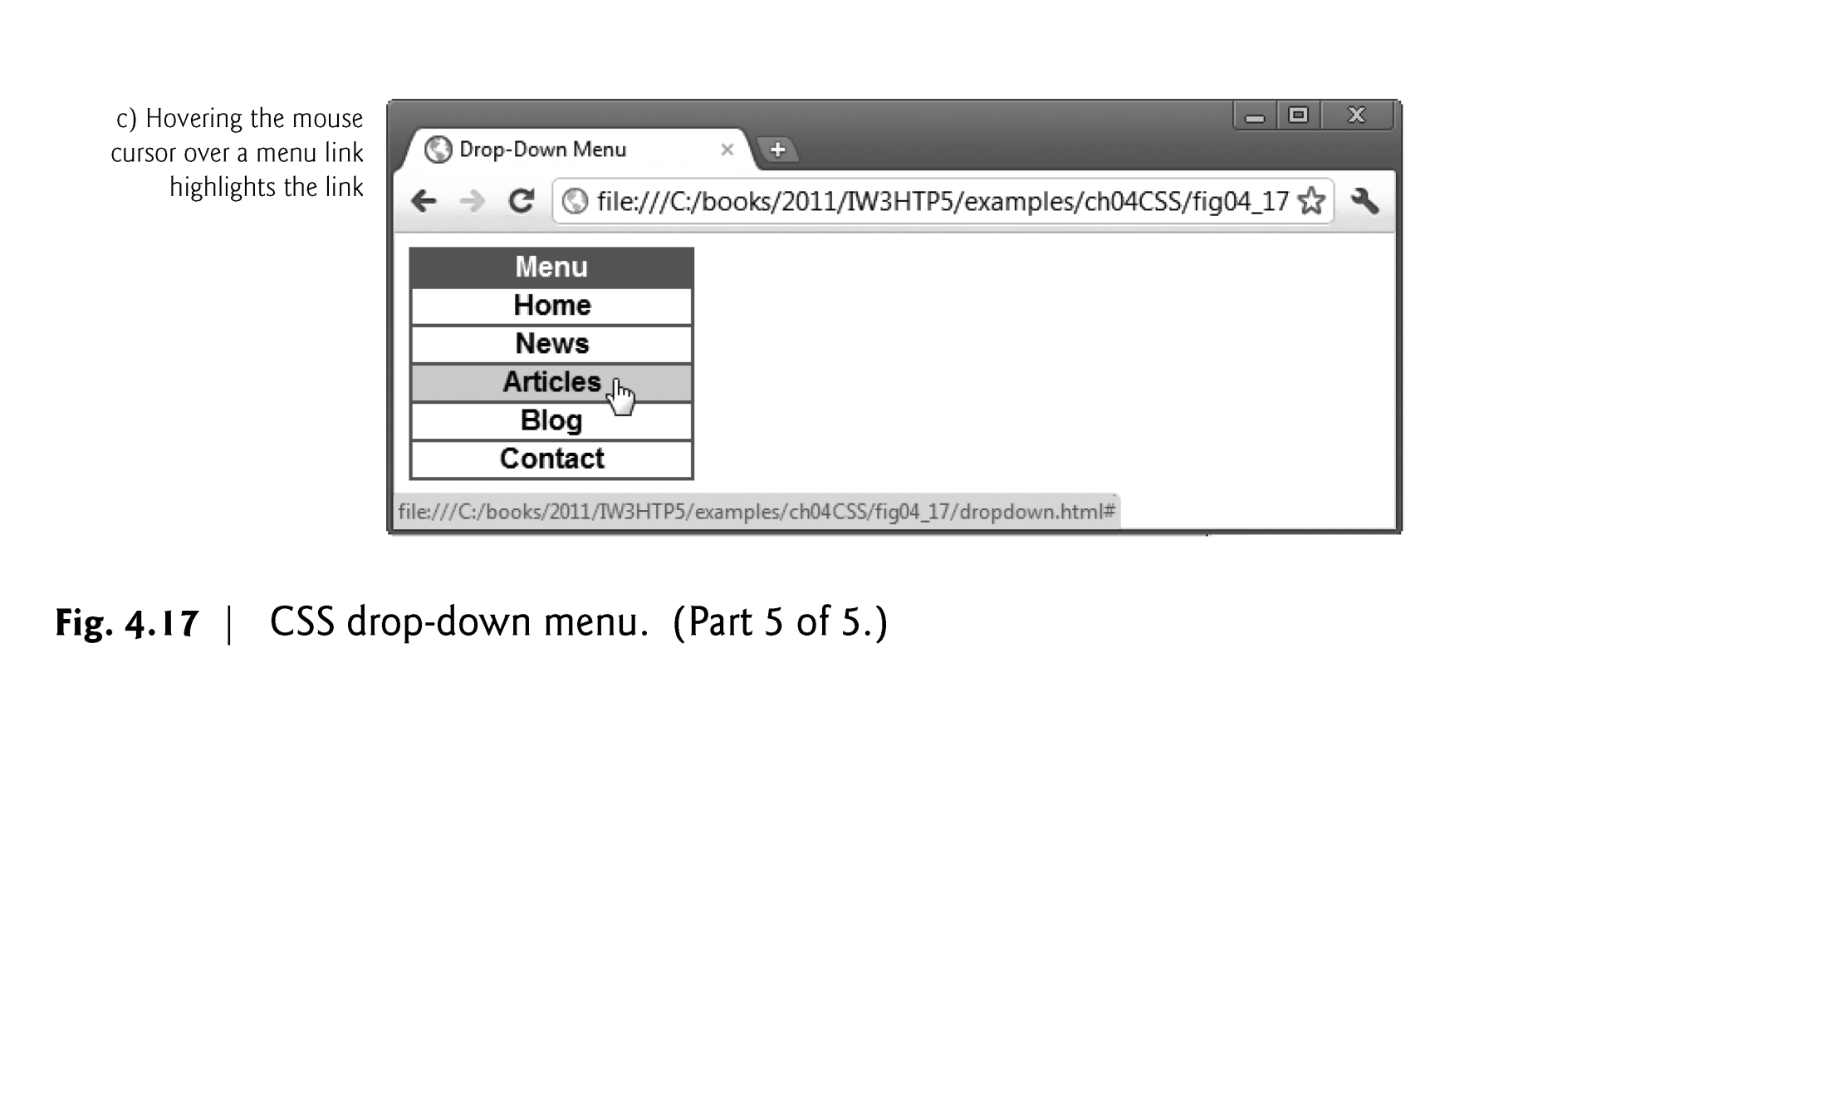

Slide 117
4.13 (Optional) User Style Sheets
Users can define their own user style sheets to format pages based on their preferences
Absolute font size measurements override user style sheets, while relative font sizes will yield to a user-defined style
User style sheets are not linked to a document; rather, they are set in the browser’s options

Slide 118
4.13 (Optional) User Style Sheets
Figure 4.18 contains an author style.
User style sheets are external style sheets. Figure 4.19 shows a user style sheet that sets the body’s font-size to 20pt, color to yellow and background-color to navy. The font-size value specified in the user style sheet conflicts with the one in line 10 of Fig. 4.18.

Slide 119
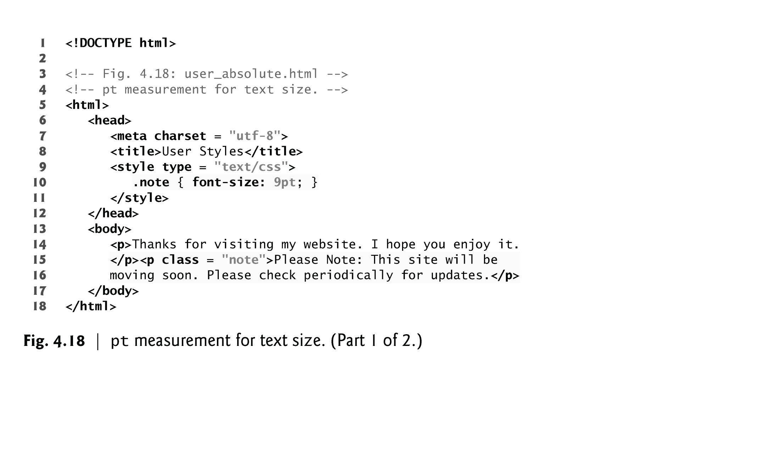

Slide 120
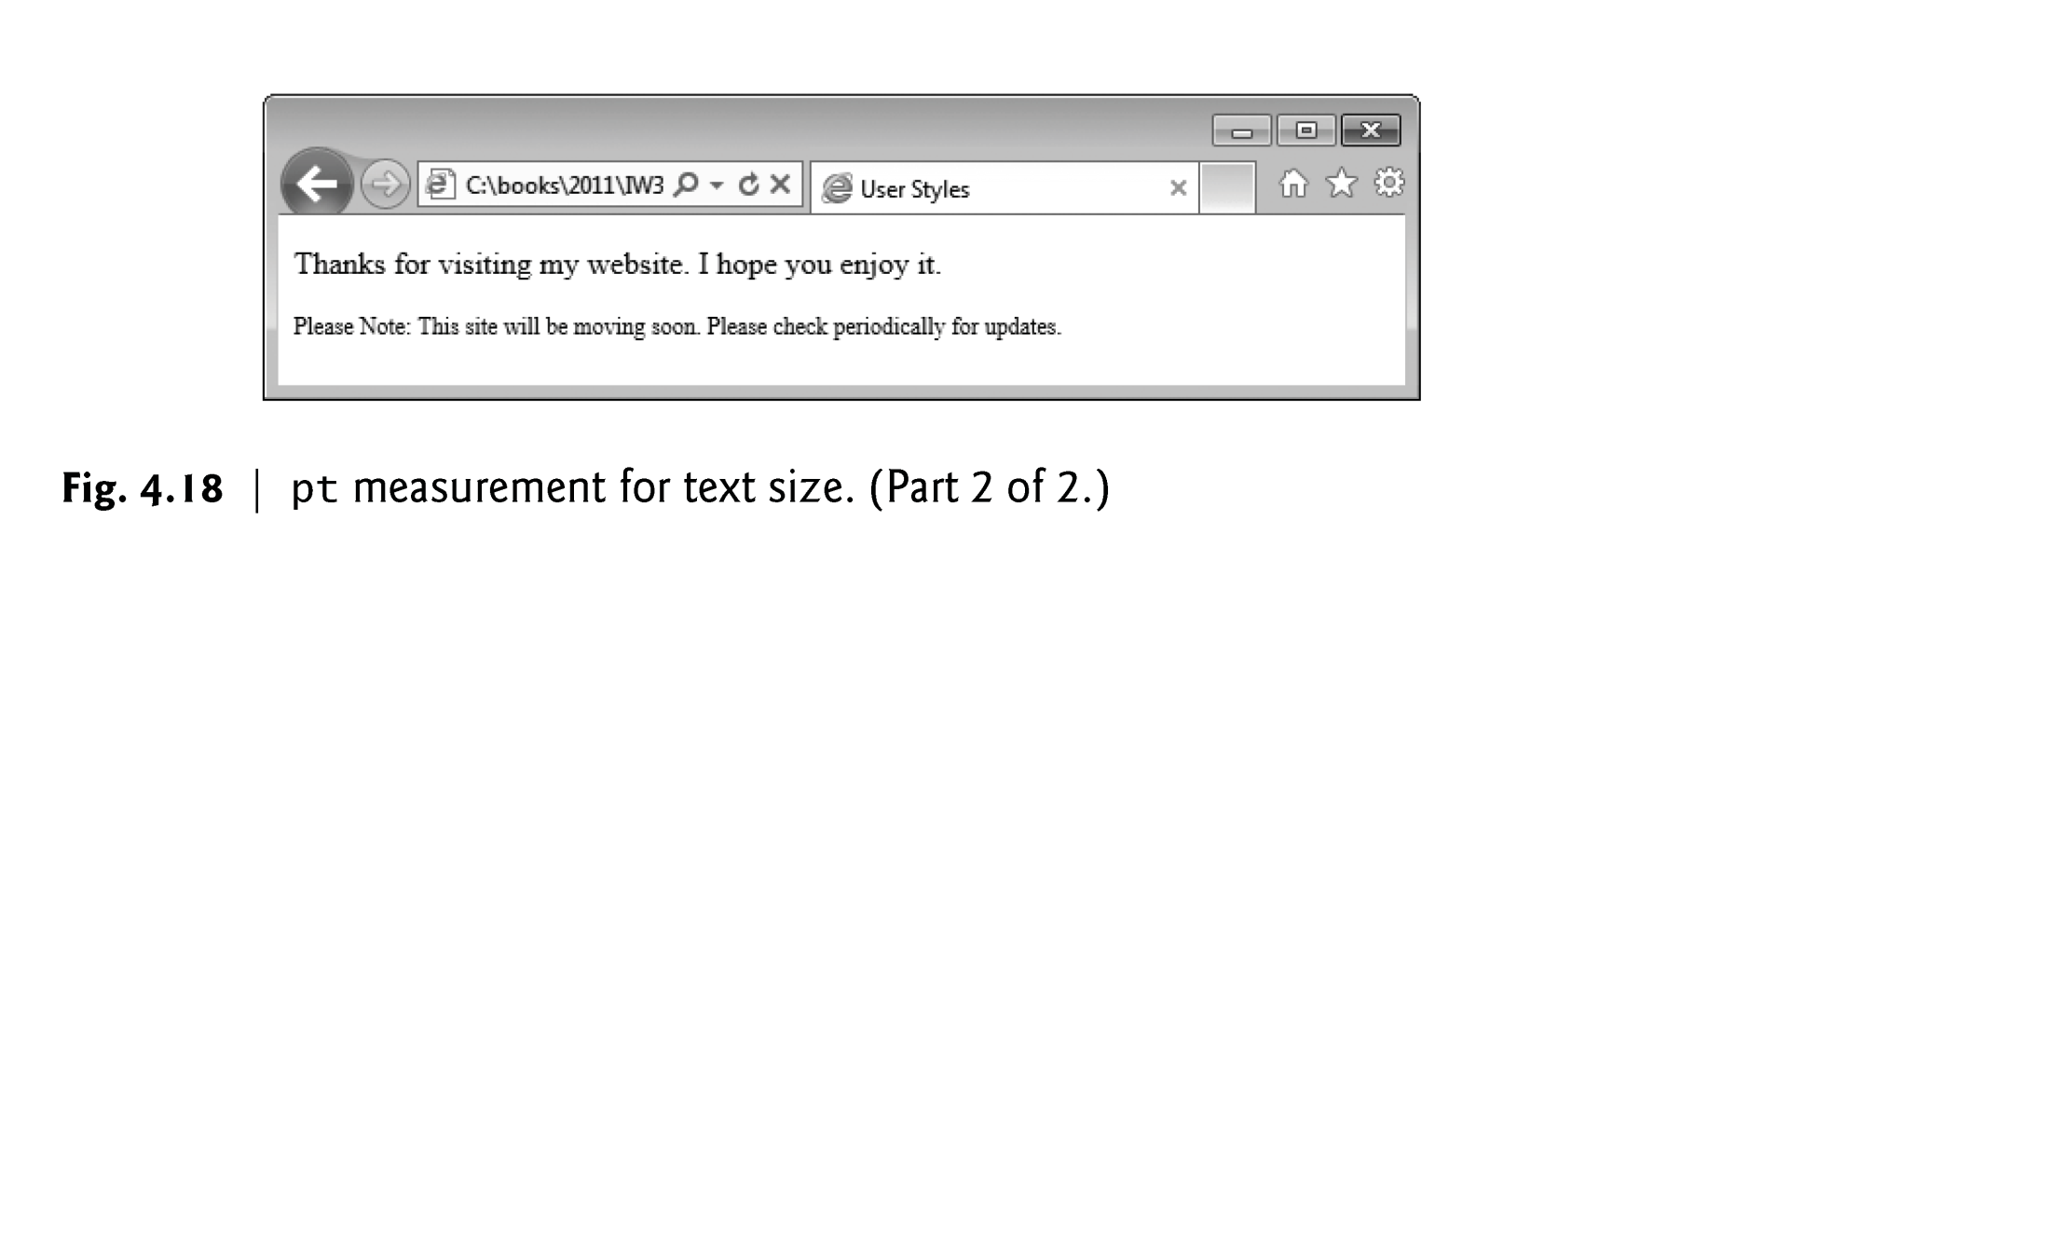

Slide 121
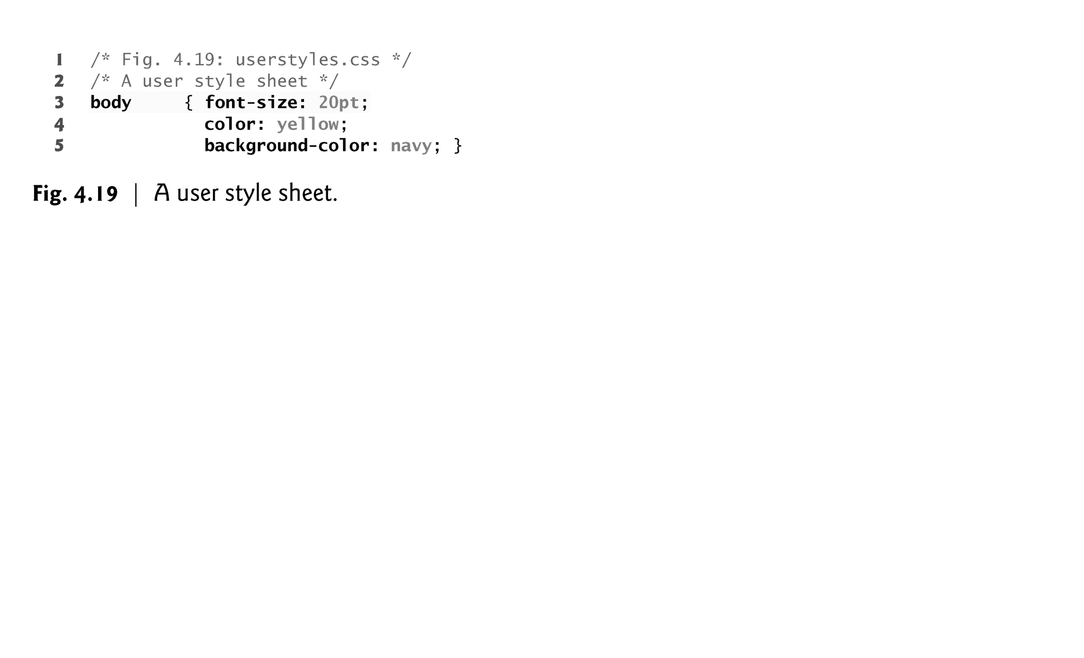

Slide 122
4.13 (Optional) User Style Sheets
Adding a User Style Sheet
User style sheets are not linked to a document; rather, they’re set in the browser’s options.
To add a user style sheet in IE9, select Internet Options..., located in the Tools menu. In the Internet Options dialog (Fig. 4.20) that appears, click Accessibility..., check the Format documents using my style sheet checkbox, and type the location of the user style sheet.
To add a user style sheet in Firefox, find your Firefox profile using the instructions at
www.mozilla.org/support/firefox/profile#locate
Place a style sheet called userContent.css in the chrome subdirectory.
For information on adding a user style sheet in Chrome, see
www.google.com/support/forum/p/Chrome/thread?tid=1fa0dd079dbdc2ff&hl=en.

Slide 123
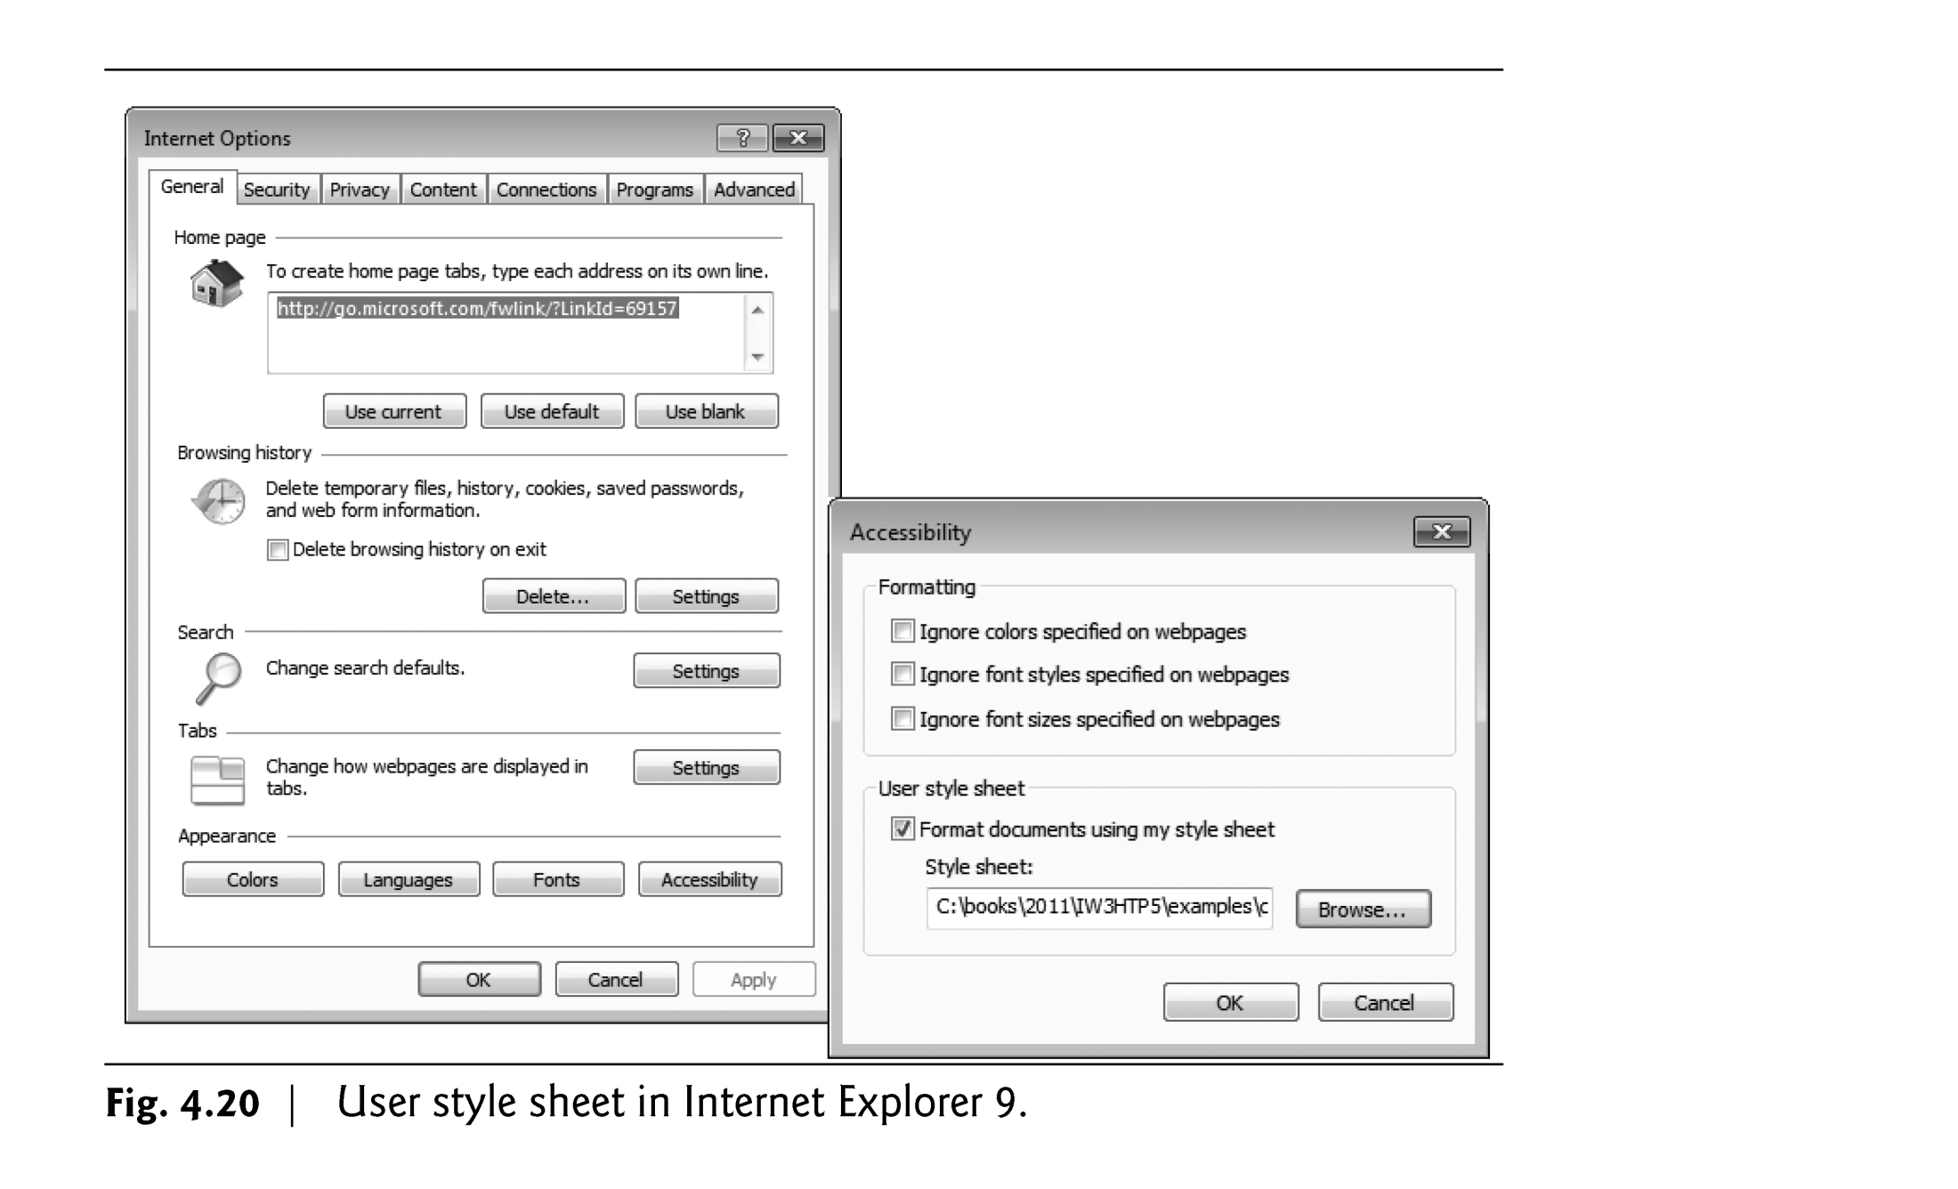

Slide 124
4.13 (Optional) User Style Sheets
The web page from Fig. 4.18 is displayed in Fig. 4.21, with the user style sheet from Fig. 4.19 applied.

Slide 125
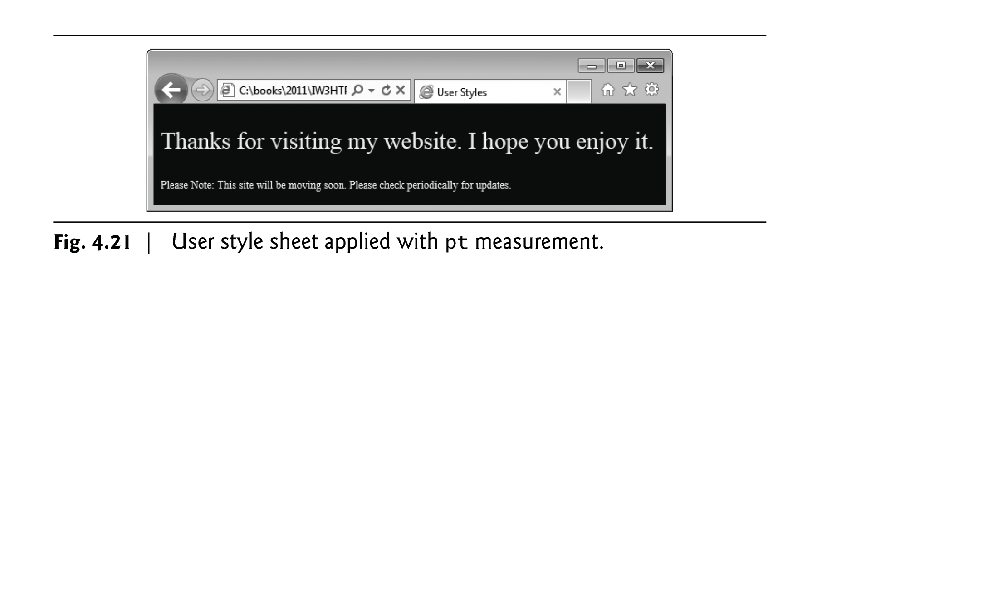

Slide 126
4.13 (Optional) User Style Sheets
Defining font-size in a User Style Sheet
Figure 4.22 changes the font-size property to use a relative measurement that does not override the user style set in Fig. 4.19.
Instead, the font size displayed is relative to the one specified in the user style sheet.

Slide 127
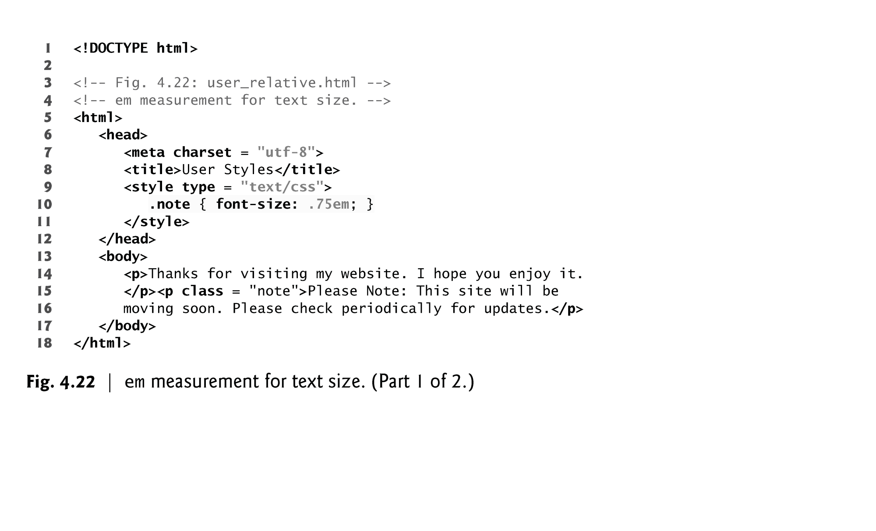

Slide 128


Slide 129
4.13 (Optional) User Style Sheets
Figure 4.23 displays the web page from Fig. 4.22 in Internet Explorer with the user style sheet from Fig. 4.19 applied.
Note that the second line of text displayed is larger than the same line of text in Fig. 4.21.

Slide 130


